Slide 1
Girl Scouts Overseas
Troop Renewal Registration
Process
Notes:
Welcome to the Girl Scouts Overseas Troop Renewal Registration Process Training

Slide 2
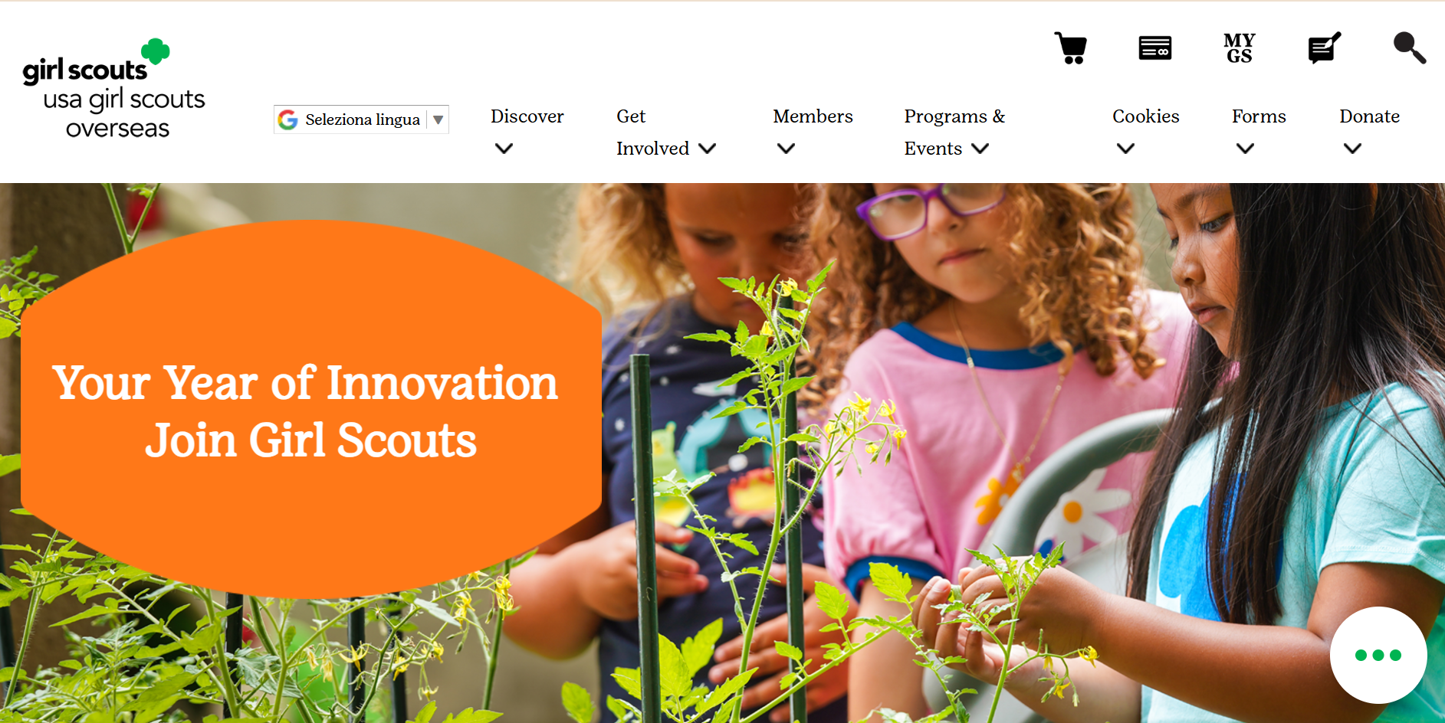


Notes:
On the USAGSO.ORG website, search for the MYGS tab on top of the screen

Slide 3
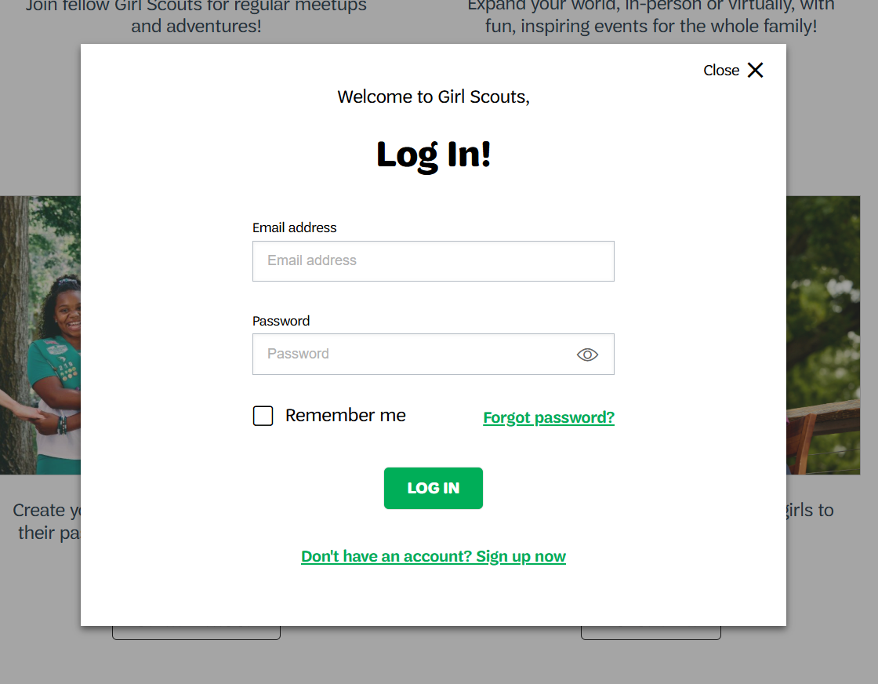
Notes:
A member pop-up window will ask to log in.
Log in into MyGS by using the credentials assigned.

Slide 4
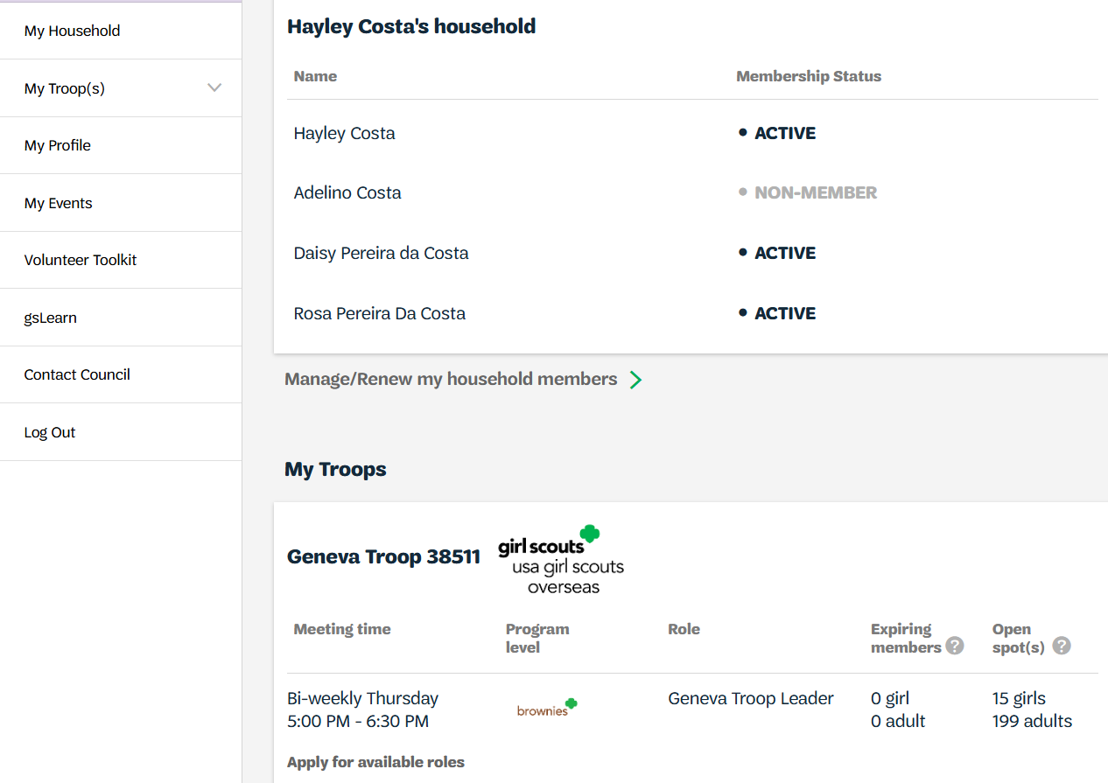
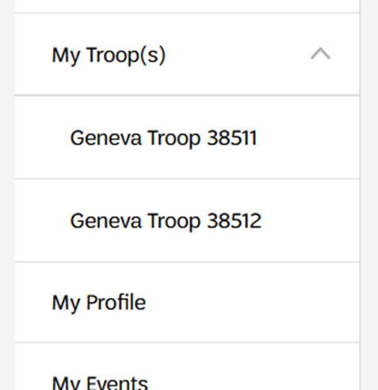
Notes:
Under the MyGS account:
The troop associates to the troop leader will be visible under the main Household page.
To access the troop details and troop rosters for renewals, click on MyTroop(s) on the side column.
Choose troop to be renewed, click to the one that applies.

Slide 5
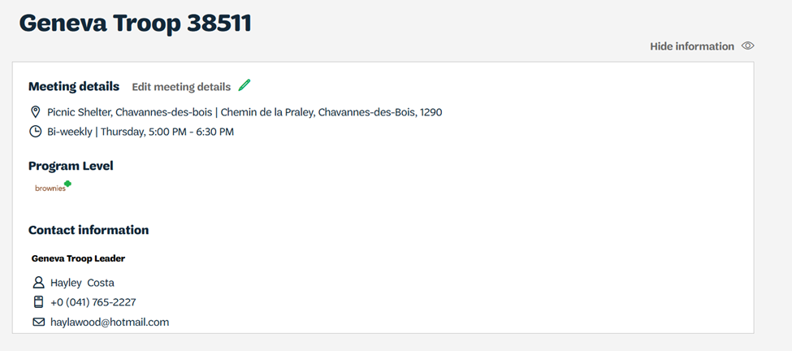
Notes:
Troop detailed information can be viewed here.
To hide the troop information, click on “hide information”

Slide 6
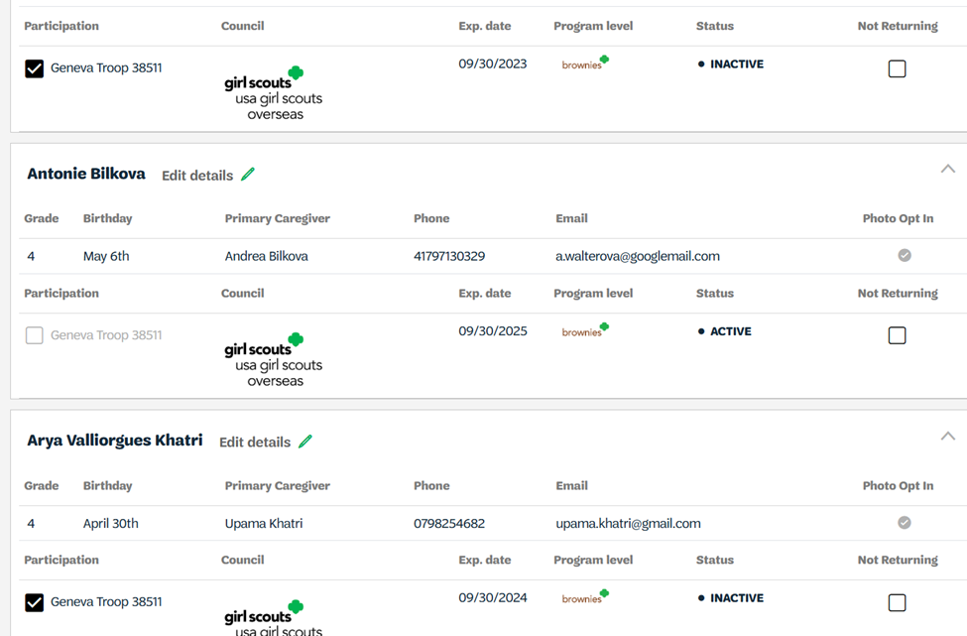
Notes:
Troop members are also visible on this page.
To view inactive members, click on “show inactive and not returning members”
Also, on the same page, multiple selection of girl members can be made. Click the box next to the renewing girl to continue with the registration process.

Slide 7
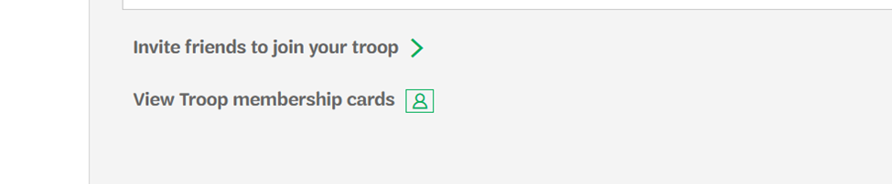
Notes:
At the bottom of the page, individual member cards can be viewed.

Slide 8
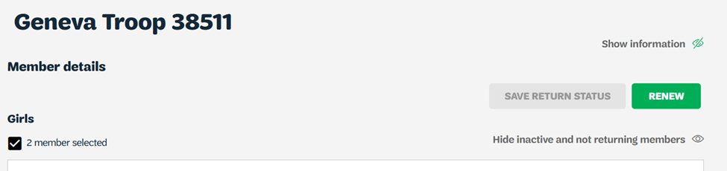
Notes:
Once the selected girls have been chosen, scroll to the top of the page to review the number of girls to be renewed and then click “Renew”

Slide 9
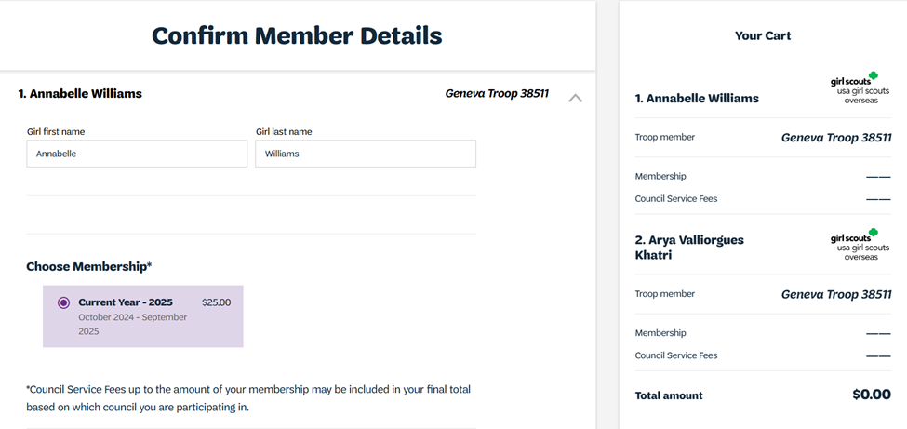
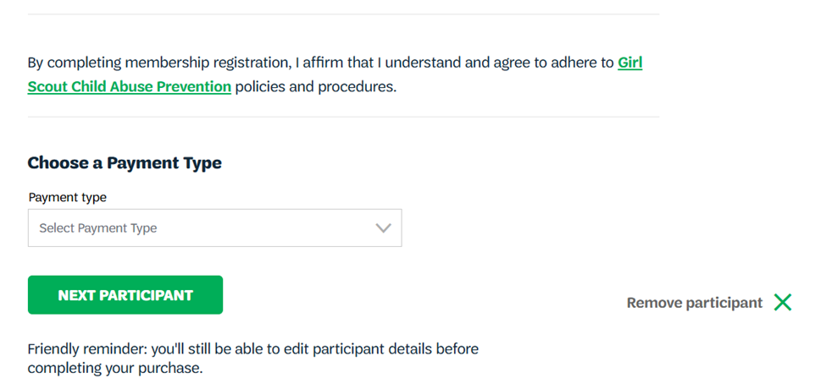
Notes:
Review each member’s details to complete the renewal.
Select payment method and click on “Next Participant” to view the next girl in the cart.
Continue the same process for every renewing girl and click “save”

Slide 10
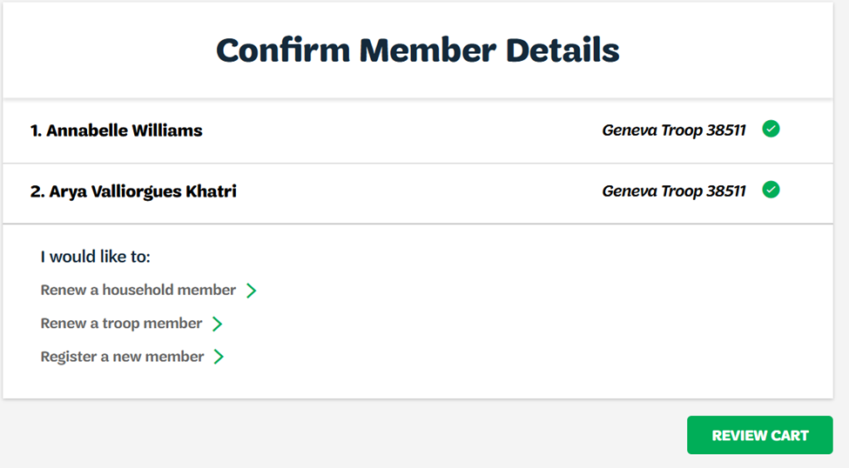
Notes:
Review Cart

Slide 11
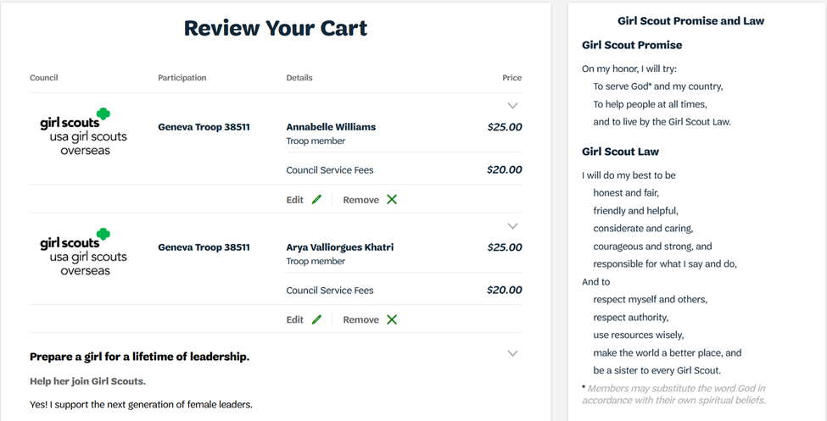
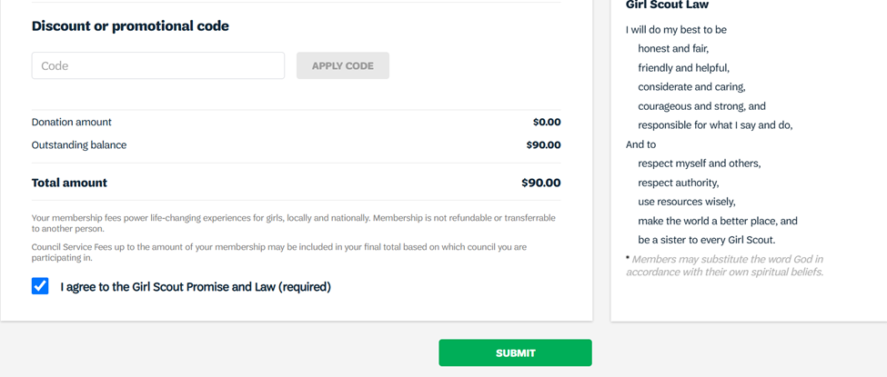
Notes:
Review the cart to check for possible errors
Click on “I agree to the Girl Scouts Promise and Law”
Click “Submit”

Slide 12
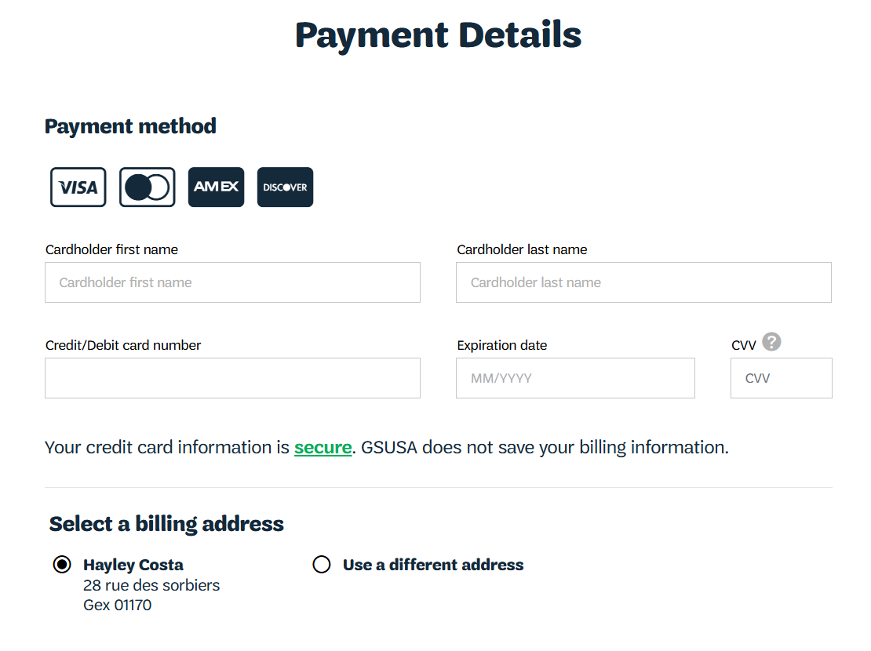
Notes:
Add payments details
If you are having issues with your credit card, please contact the Girl Scouts Overseas Customer Care for assistance. Payment confirmation will be received via email.

Slide 13
Thank you for participating!
For further questions, please contact Girl Scouts Overseas Customer Care at overseascustomercare@girlscouts.org
Notes:
Thank you for attending the Girl Scouts Overseas Adult Renewal training. For further questions or need any assistance, please contact the Girl Scouts Overseas Customer Care Team at overseascustomercare@girlscouts.org

