Slide 1
Girl Scouts Overseas
New Girl Registration
Process

Slide 2
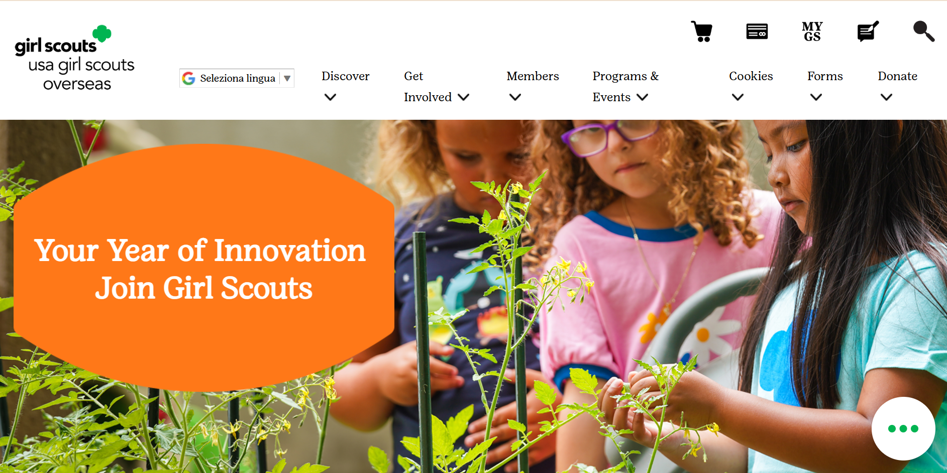


Notes:
On the USAGSO.ORG website, search for the MYGS tab on top of the screen

Slide 3
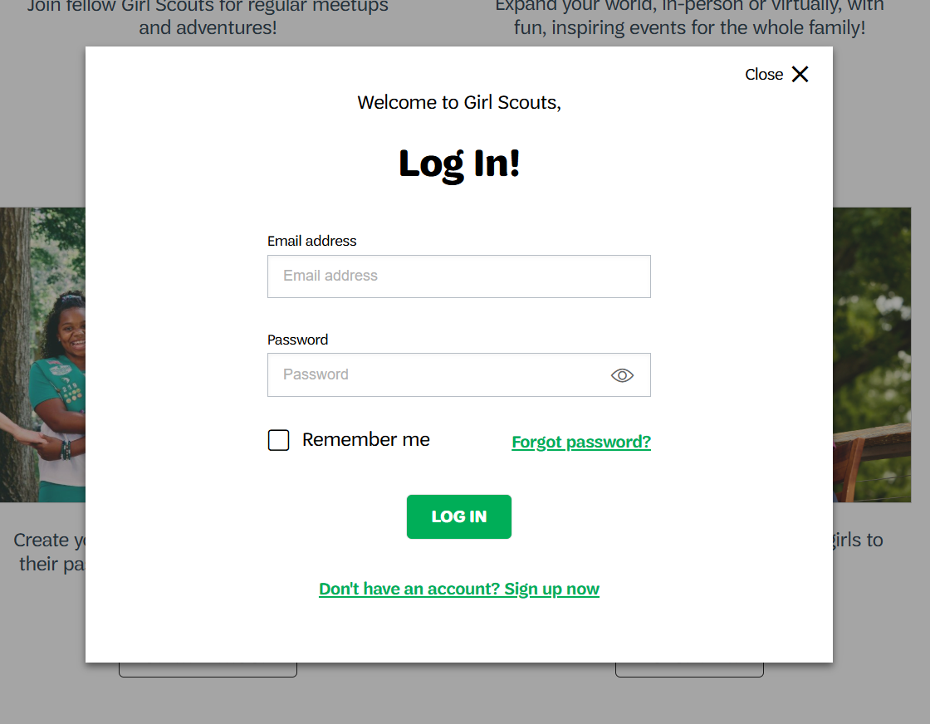
Notes:
New member pop-up window will ask to log in.
If creating a new account, click on “Don’t have an account? Sign up now”

Slide 4
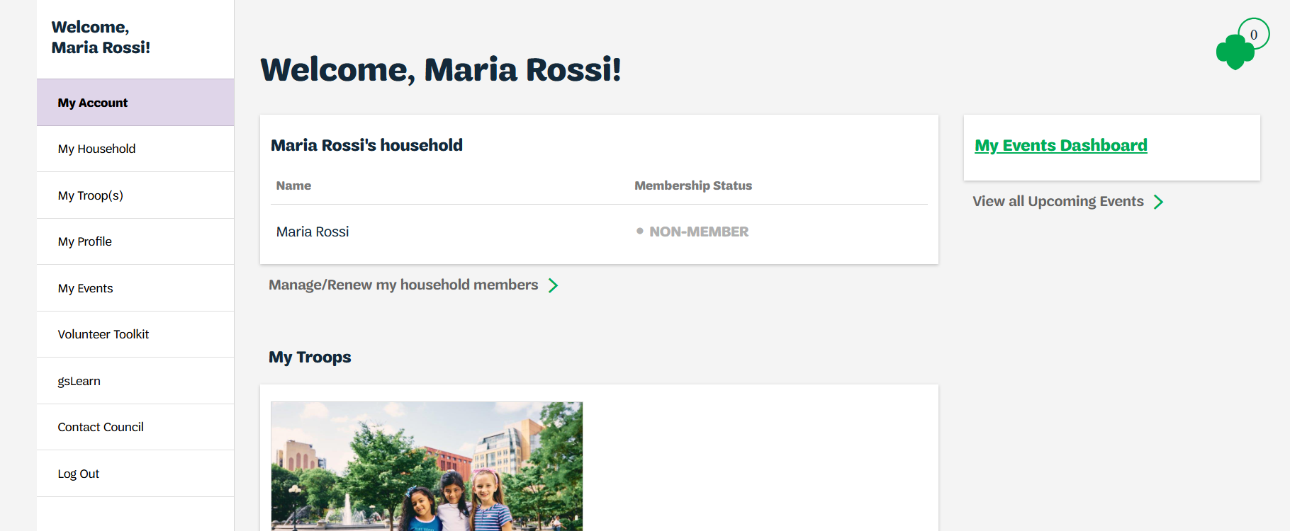
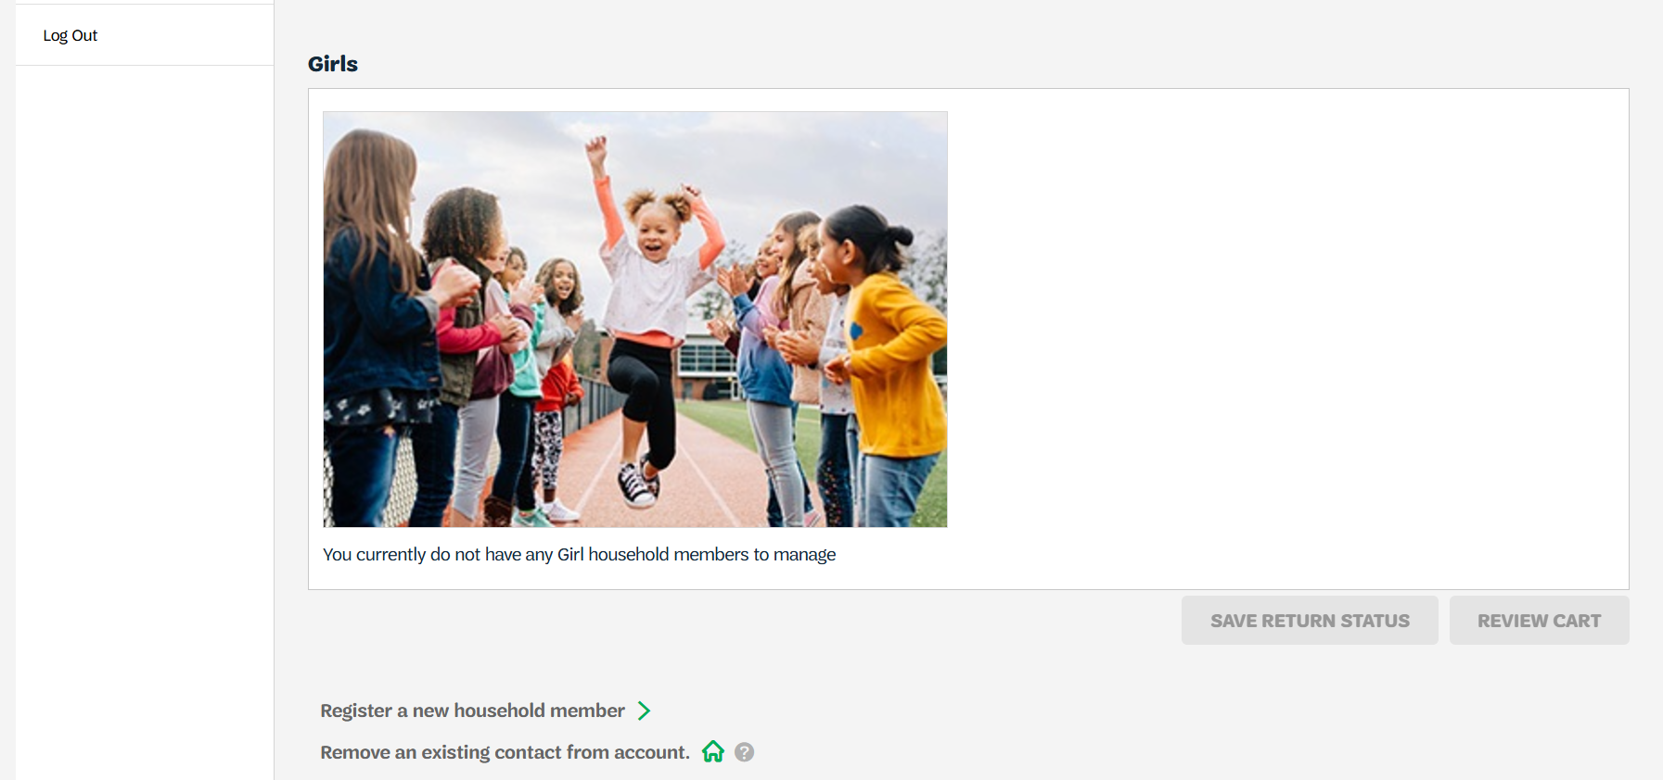
Notes:
On MyGS household account click on
Manage/renew my household members

Slide 5
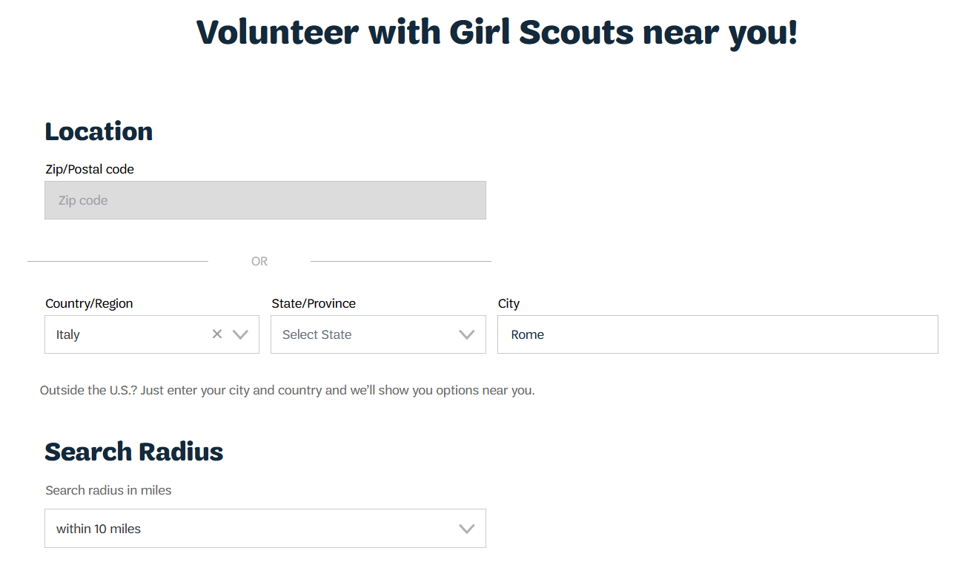
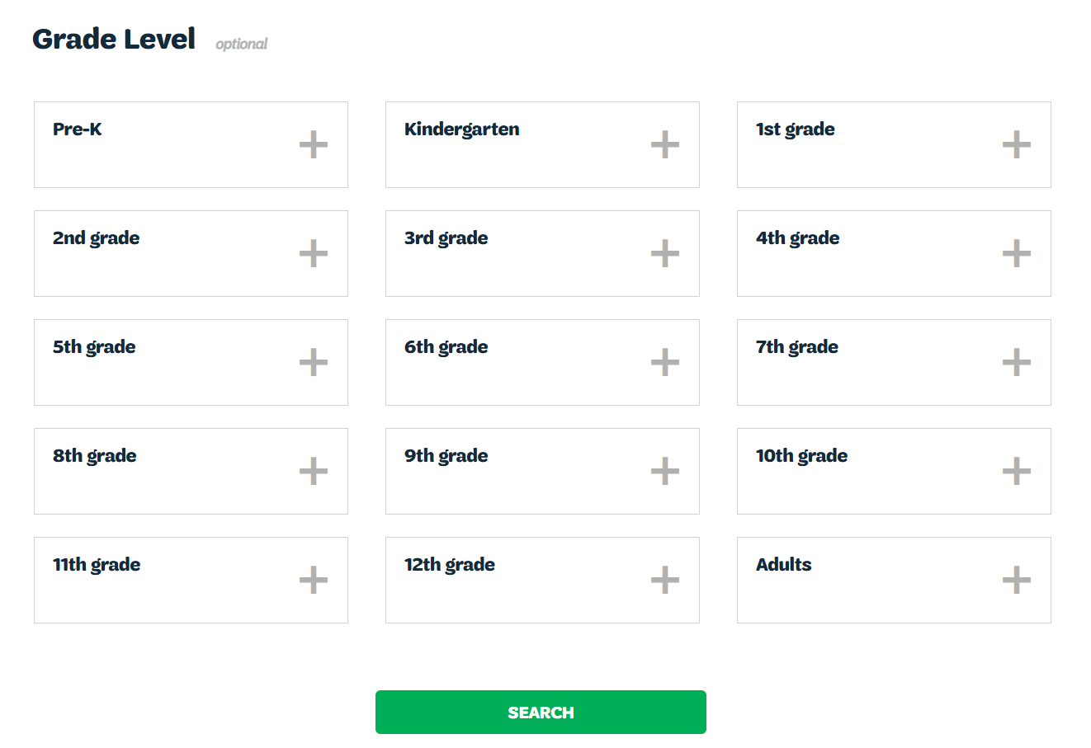
Notes:
Search for troop according to the community’s current country location.
Zip code research functionality is not available for Girl Scout Overseas for the exception of the US Virgin Islands.
If not sure in which country your community is located, please use the https://www.usagso.org/en/discover/communties.html
From Country/Region drop down menu choose the correct country where you are located
Type city name or community
Select Grade Level
Choose Current Year (other options will be available throughout the year)

Slide 6
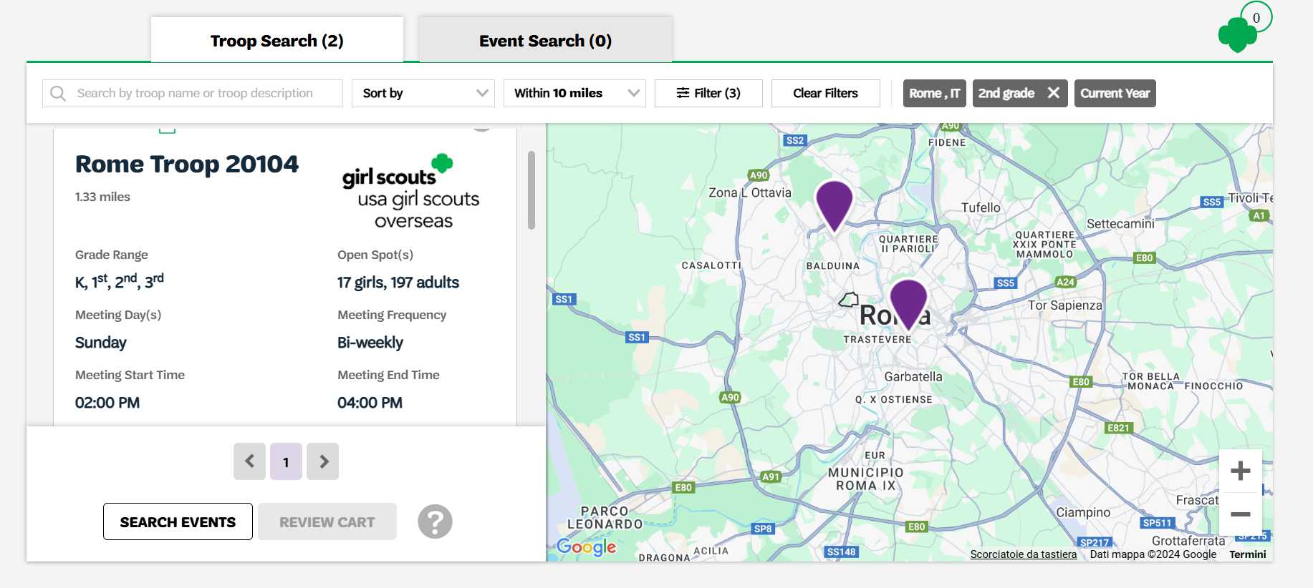
Notes:
Select troop availability
If searched troop is not available, select Unsure or Become a General Member
Select Next

Slide 7
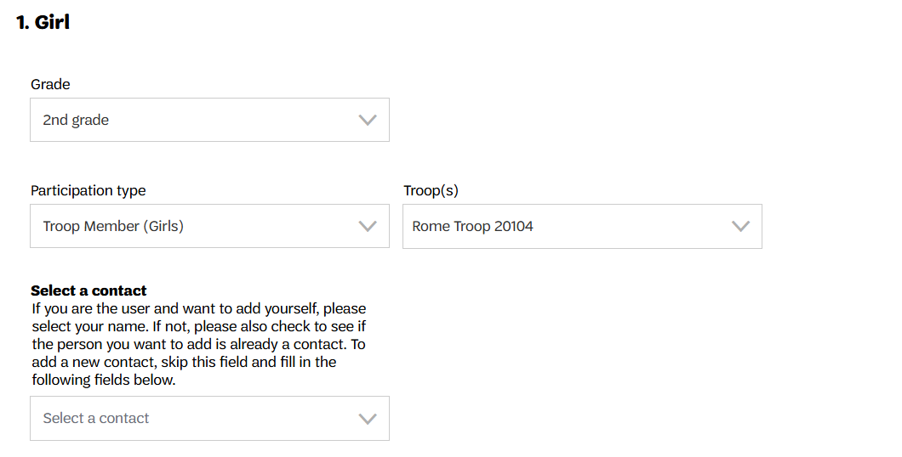
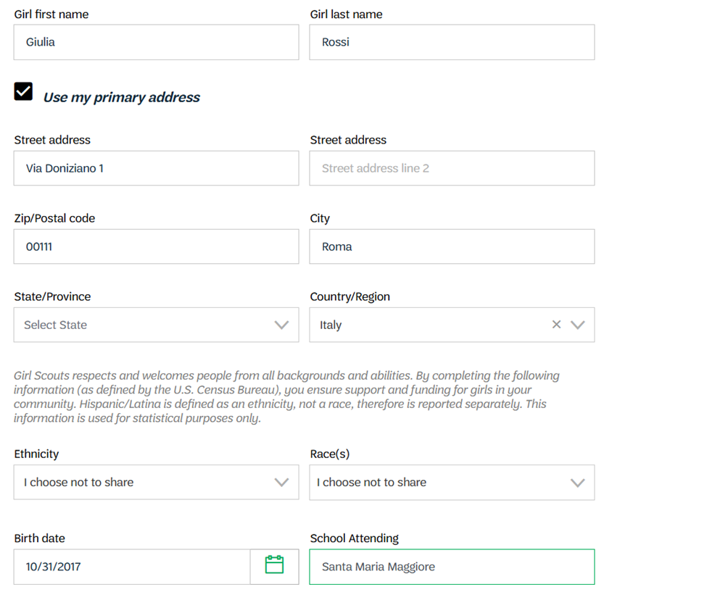
Notes:
Add details:
Grade
Participation type
Troop
Complete address information – if using an international address, make sure to select correct country
Or Click on “Use my primary address” to auto-generate the parent/guardian address
Complete all the info required
Name and Last Name
Address
Country
DOB
School
Phone number (if 12 years or older)
Phone type
Email address (if 12 years or older)

Slide 8
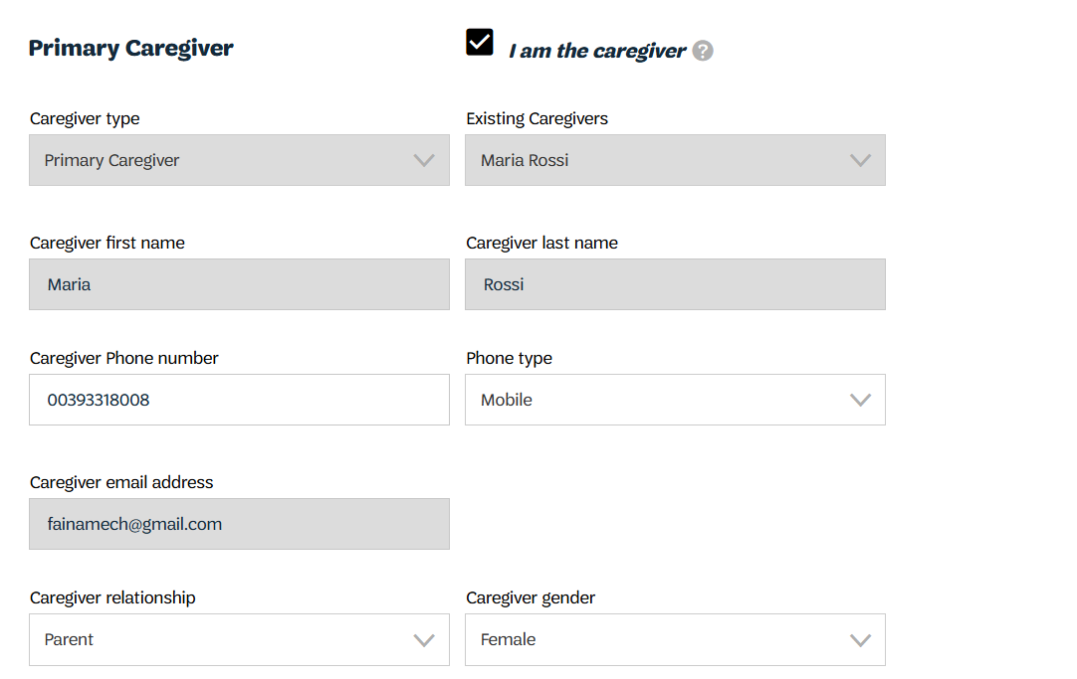
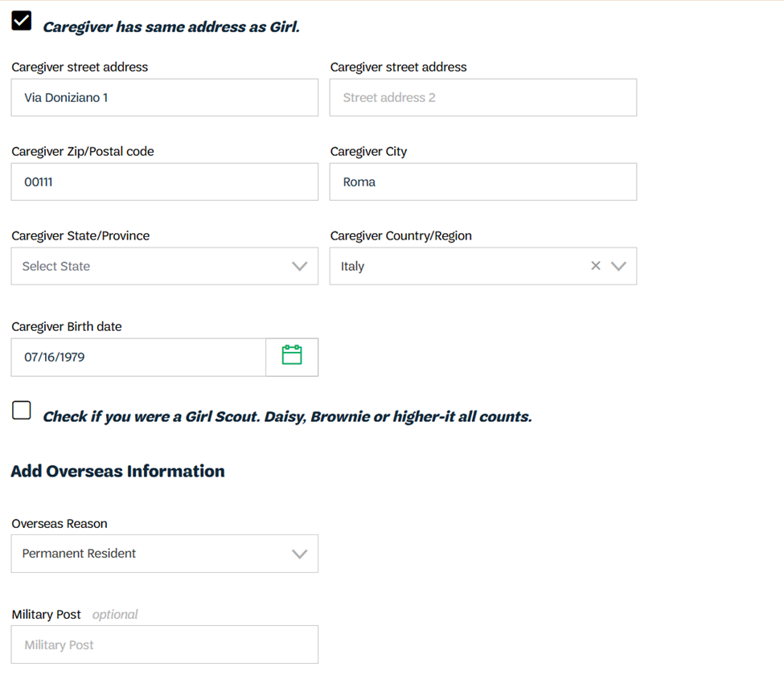
Notes:
Check “I am Caregiver” box and select Care Giver relationship
Check “Caregiver has same address as Girl”
Select “Overseas Reason”

Slide 9
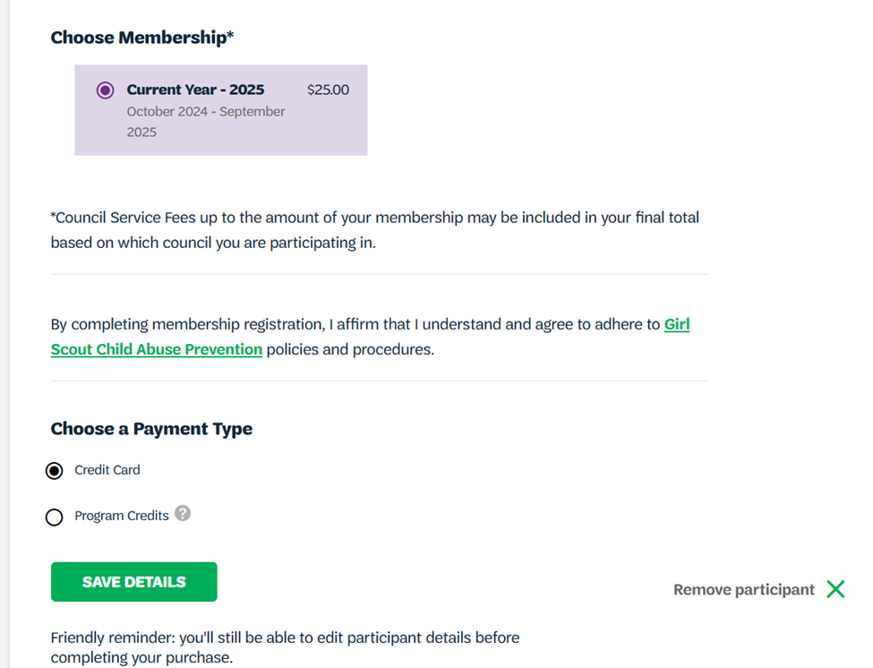
Notes:
Choose membership and payment type
USAGSO does not use Program Credits
Save details

Slide 10
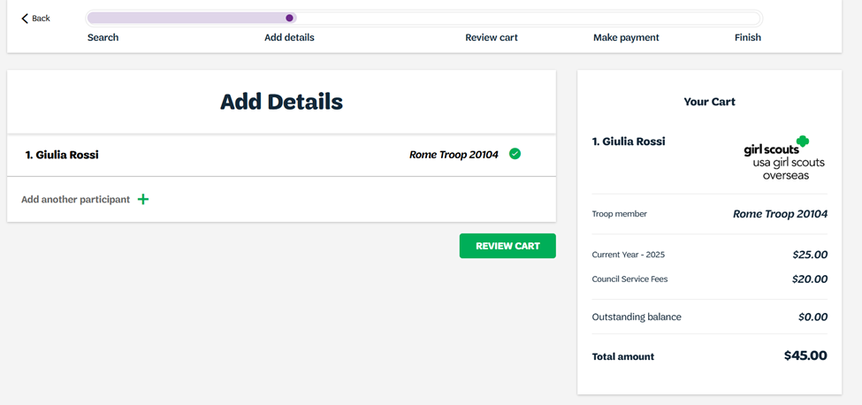
Notes:
Choose payment type
Review Cart

Slide 11
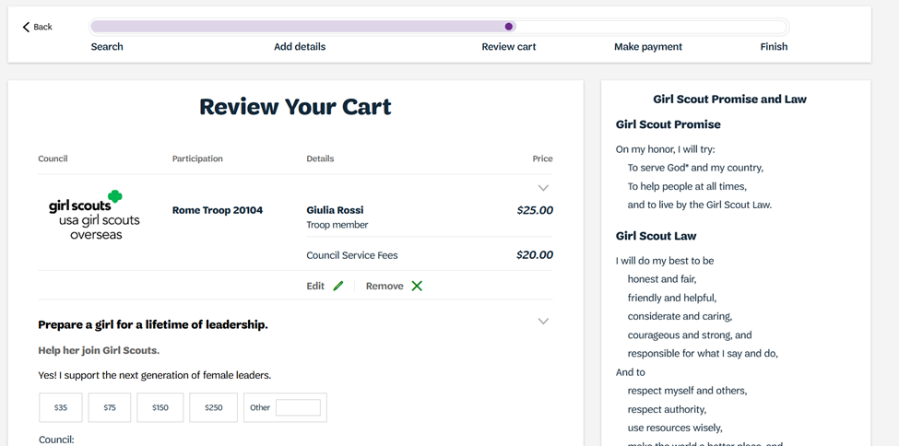
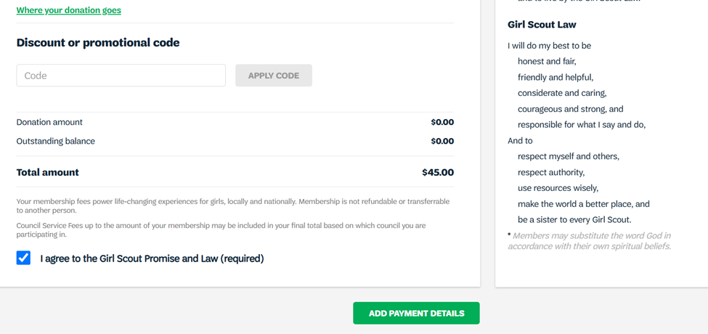
Notes:
Review your cart to check for errors
If there is a discount code available, it can be used on this page under the “Discount or promotional code tab”
Donations can also be completed in this page
Click on “I Agree to the Girl Scouts Promise and Law”
Click on “Add Payment Details”

Slide 12
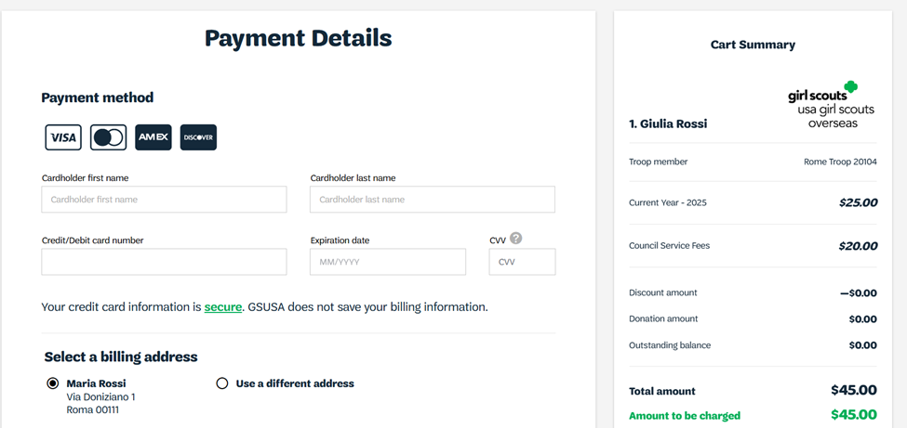
Notes:
Add payments details
If you are having issues with your credit card, please contact the Girl Scouts Overseas Customer Care for assistance. Payment confirmation will be received via email.

Slide 13
Thank you for participating!
For further questions, please contact Girl Scouts Overseas Customer Care at overseascustomercare@girlscouts.org

