Slide 1
Girl Scouts Overseas
New Adult Registration
Process
Notes:
Welcome to the Girl Scouts Overseas New Adult Registration Process training

Slide 2
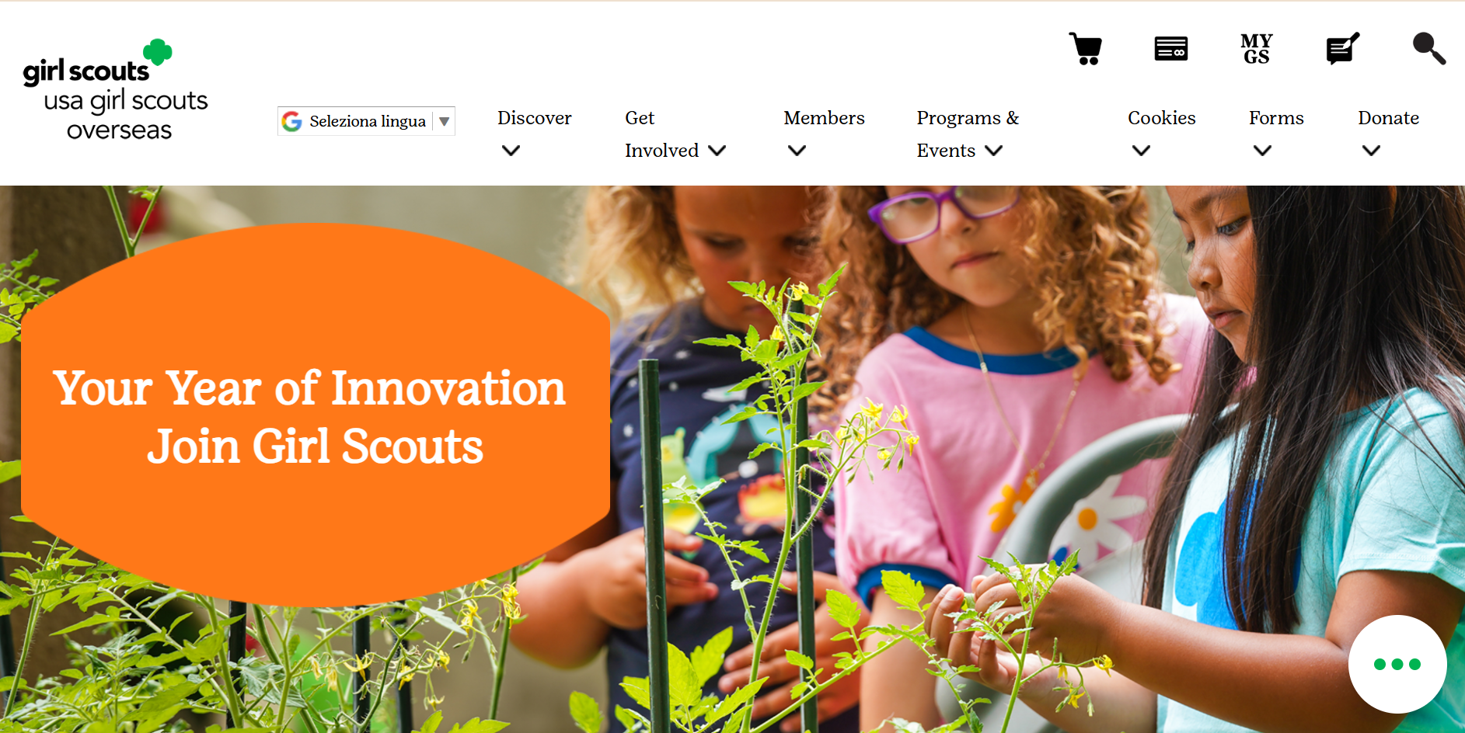
Notes:
On the USAGSO.ORG website, search for the MYGS tab on top of the screen

Slide 3
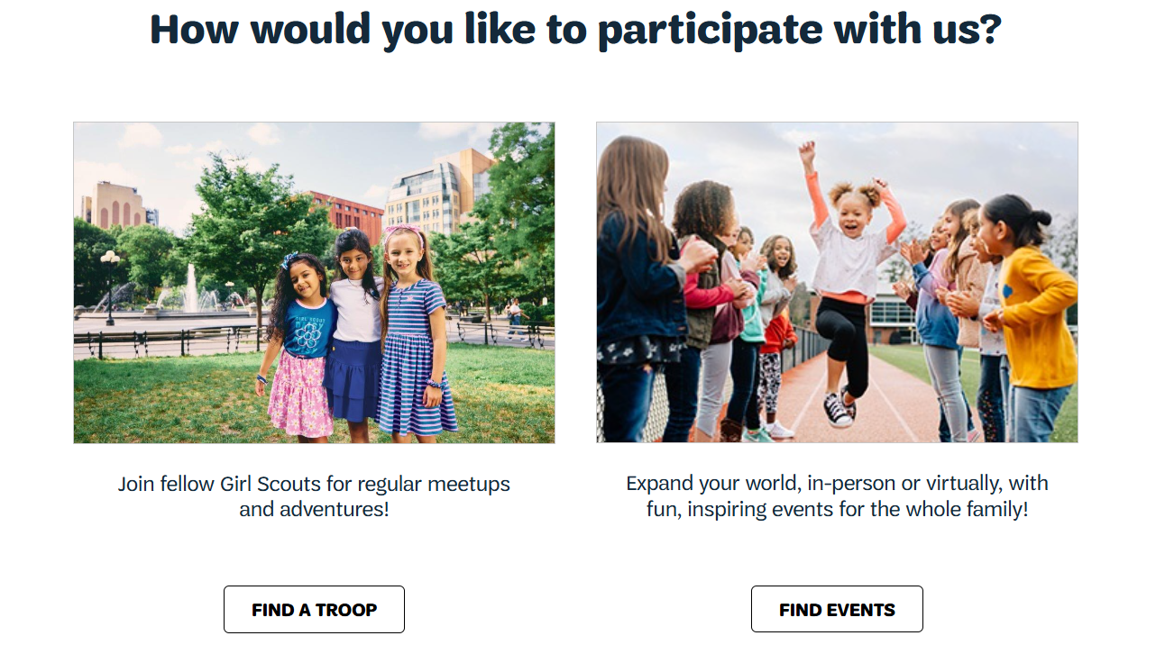
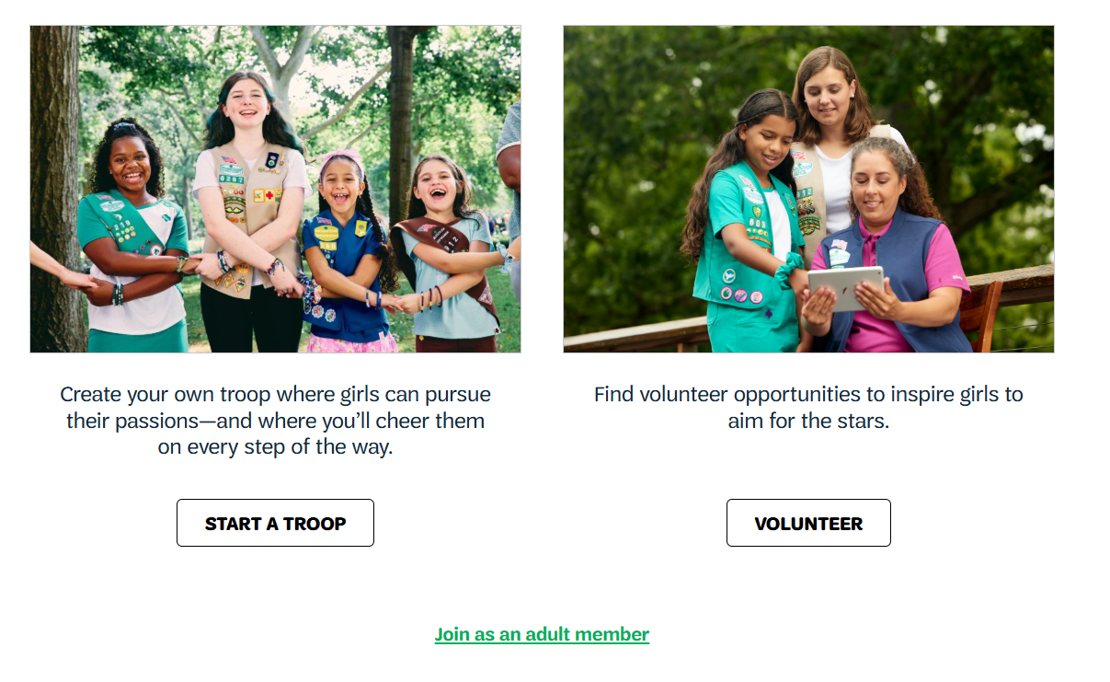
Notes:
If registering for a troop choose one of the following:
Find a Troop
Volunteer – if you would like to participate as a volunteer in your daughter’s troop

Slide 4
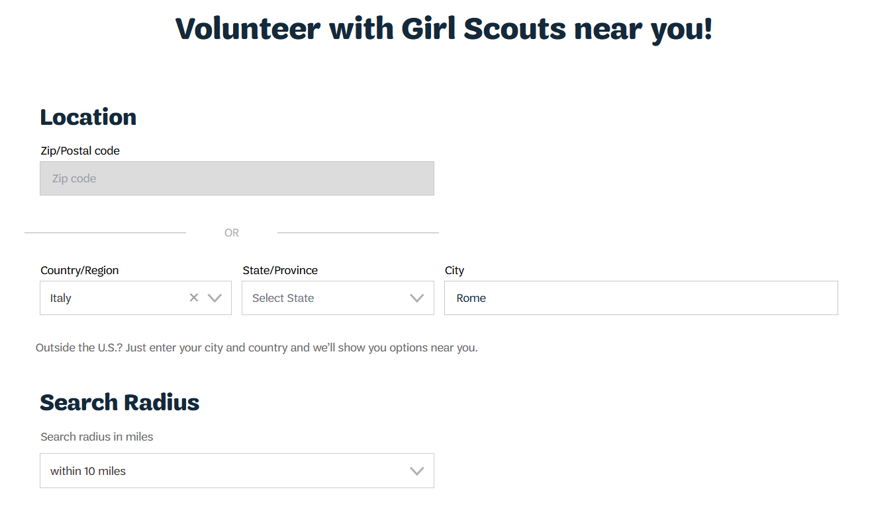
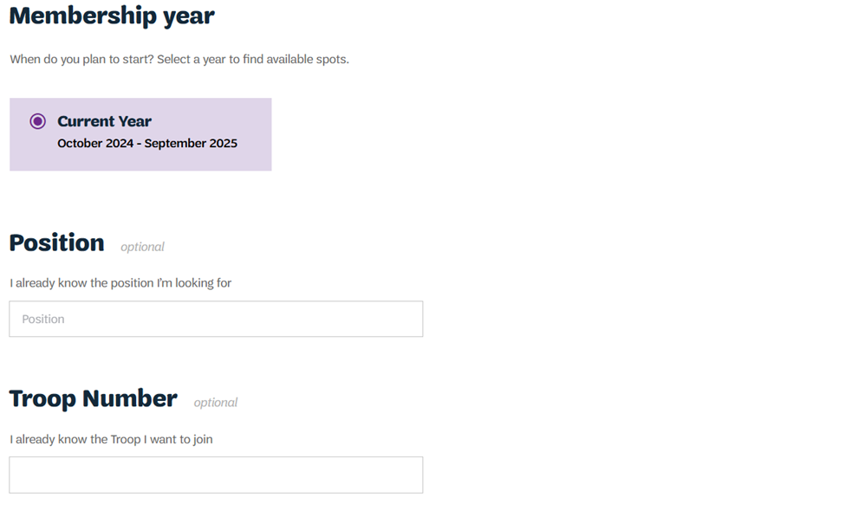
Notes:
Search for troop according to the community’s current country location.
Zip code research functionality is not available for Girl Scout Overseas for the exception of the US Virgin Islands.
If not sure in which country your community is located, please use the https://www.usagso.org/en/discover/communties.html
From Country/Region drop down menu choose the correct country where you are located
Type city name or community
Choose Current Year (other options will be available throughout the year)

Slide 5
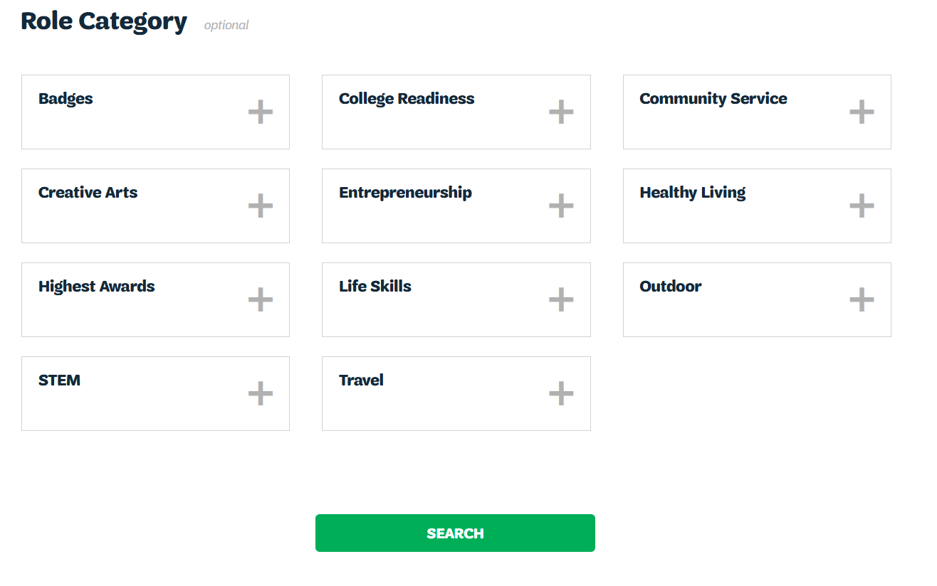
Notes:
Click appropriate Role Category if available
Click Search

Slide 6
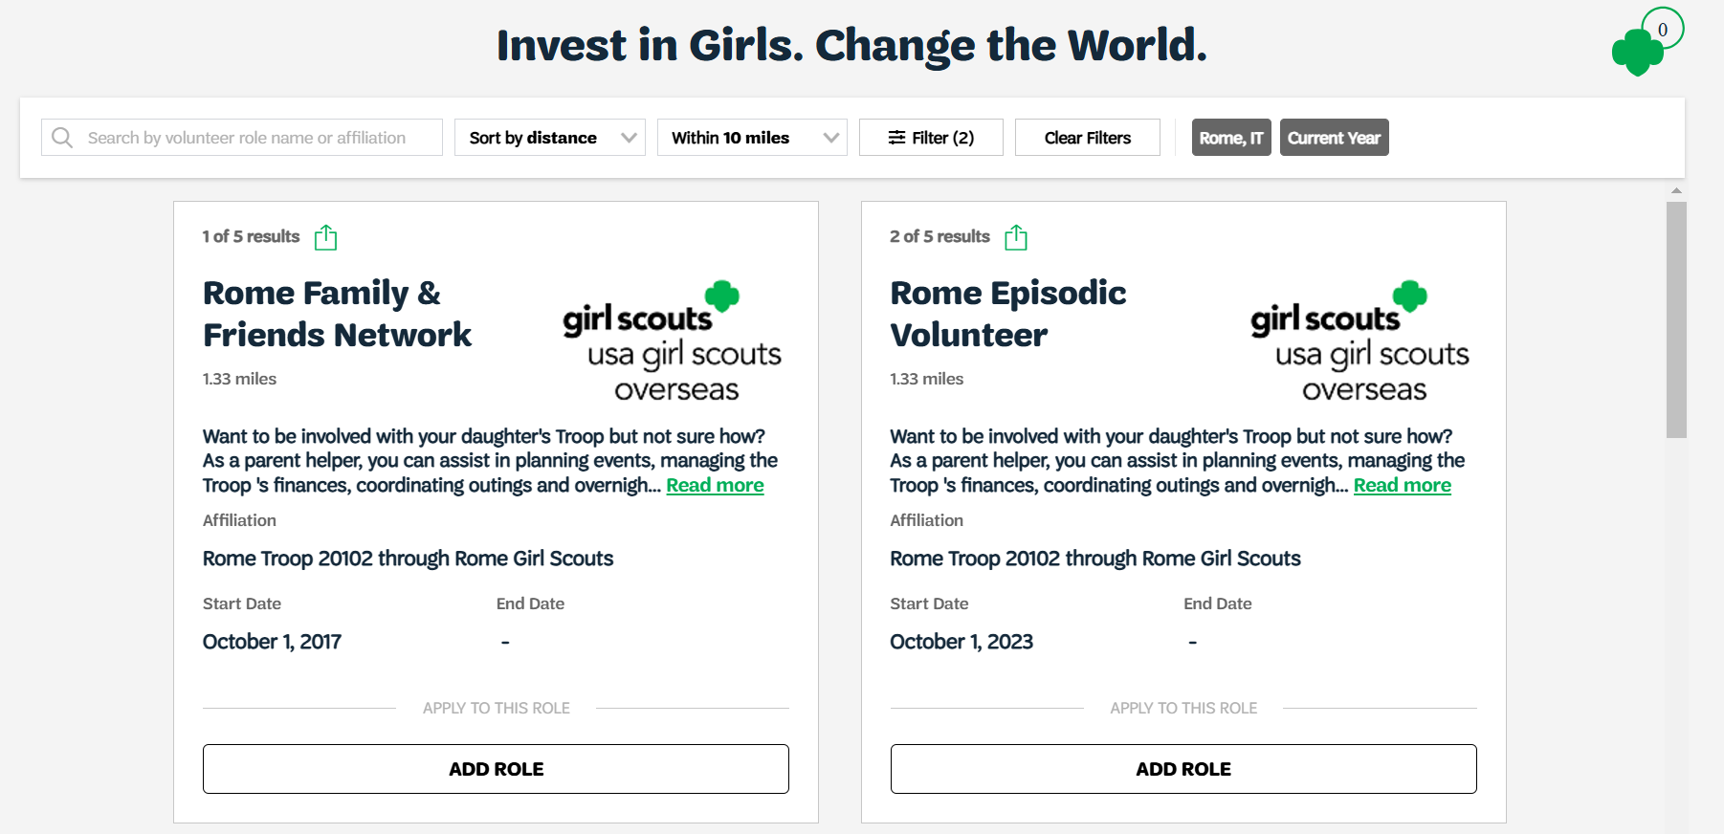
Notes:
Select troop availability
If searched troop is not available, select Unsure or Become a General Member
Click Log In

Slide 7
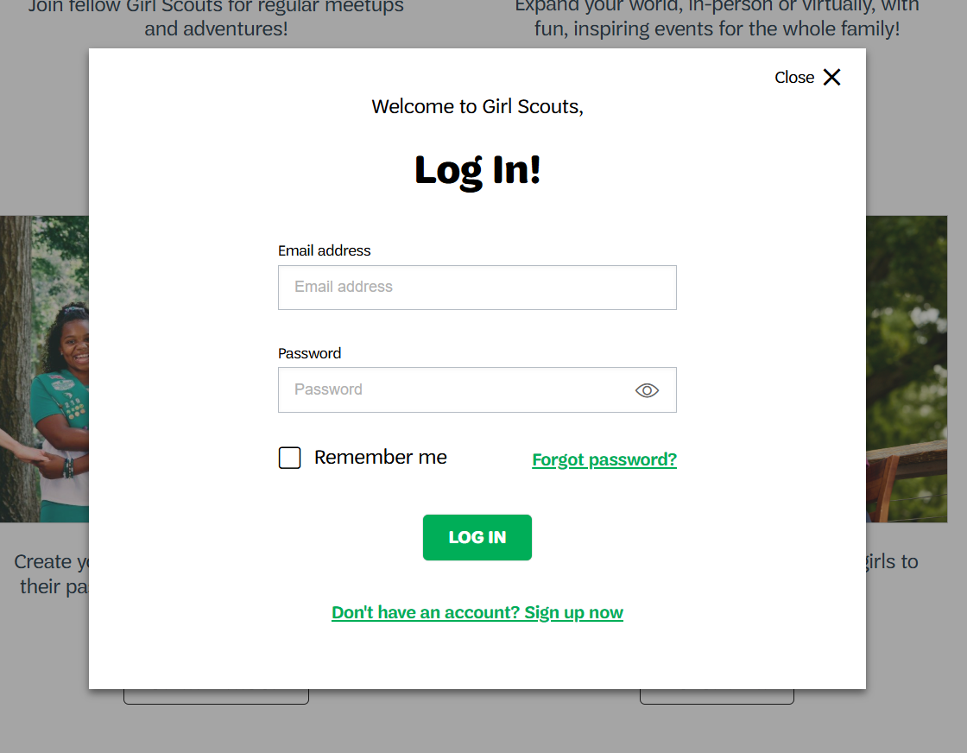
Notes:
New member pop-up window will ask to log in.
If creating a new account, click on “Don’t have an account? Sign up now”

Slide 8
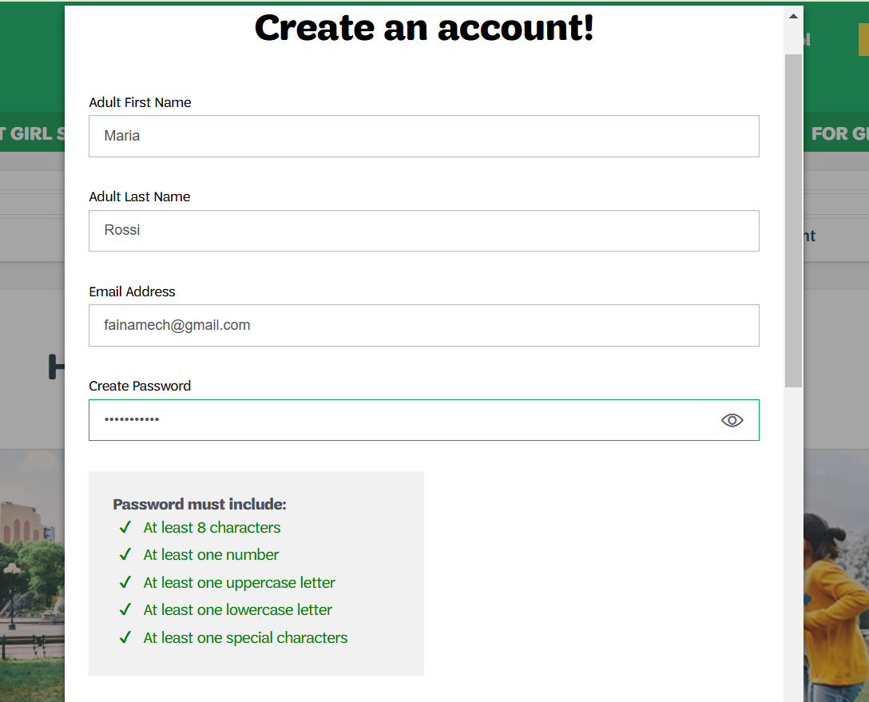
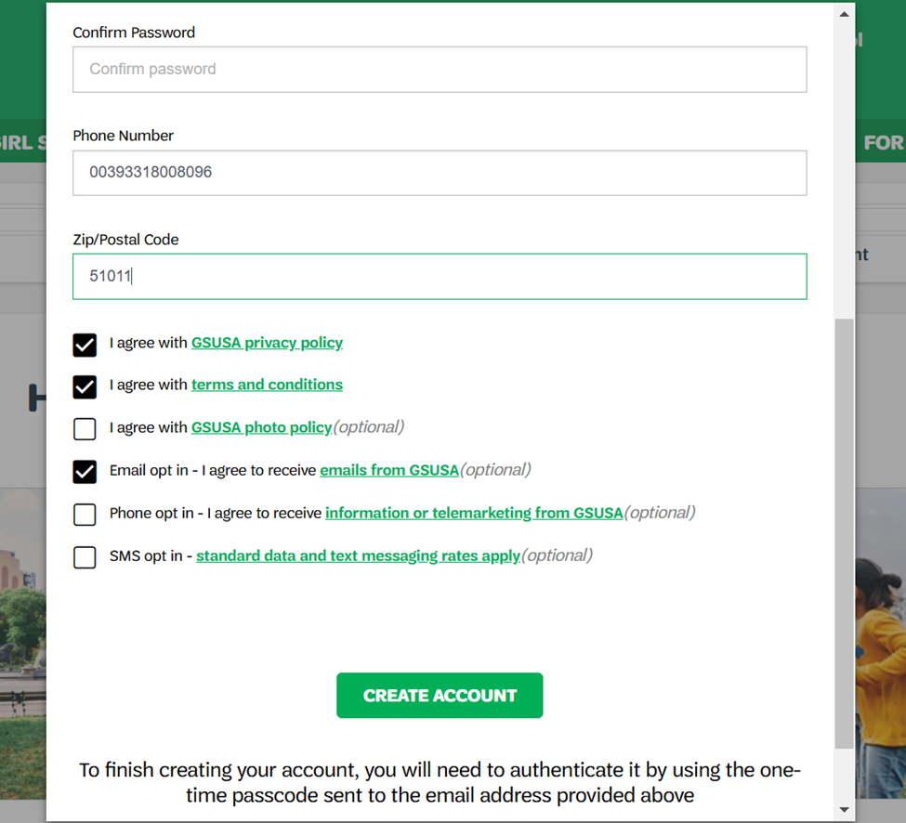
Notes:
Pop up window
Fill all information requested and click on all options that apply

Slide 9
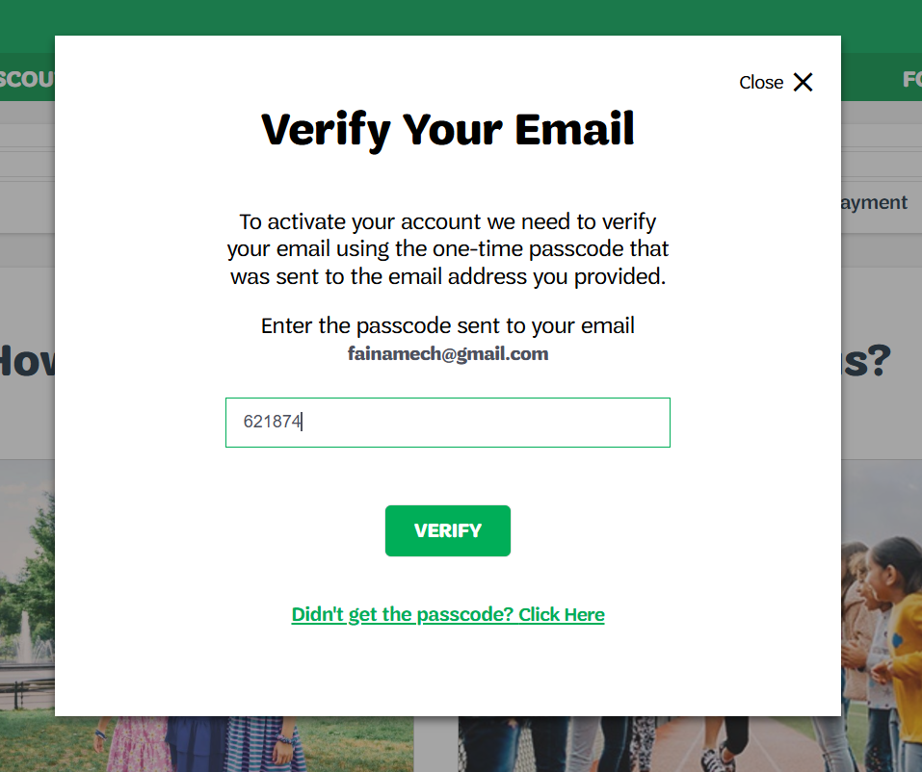
Notes:
A temporary one-time passcode will be sent to your email
Check spam/junk mail if code is not received in the inbox folder.

Slide 10
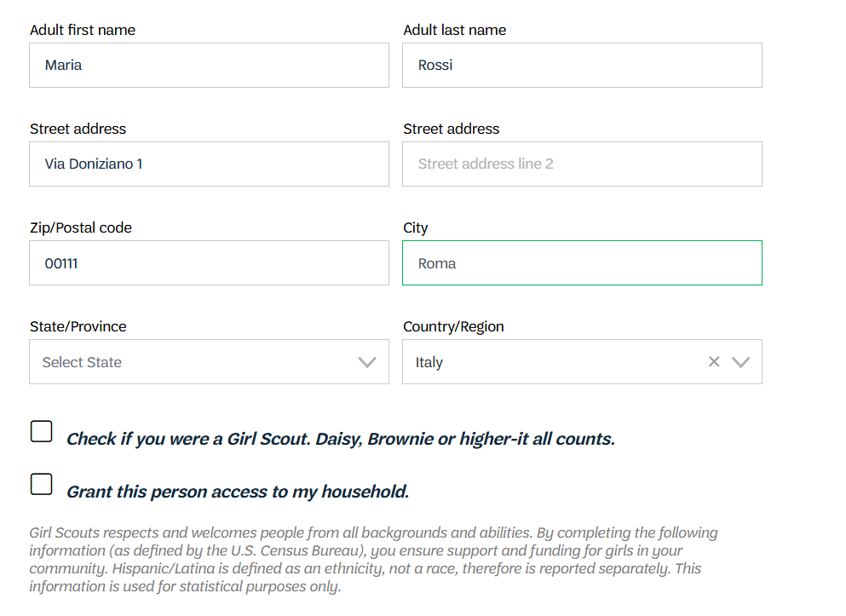
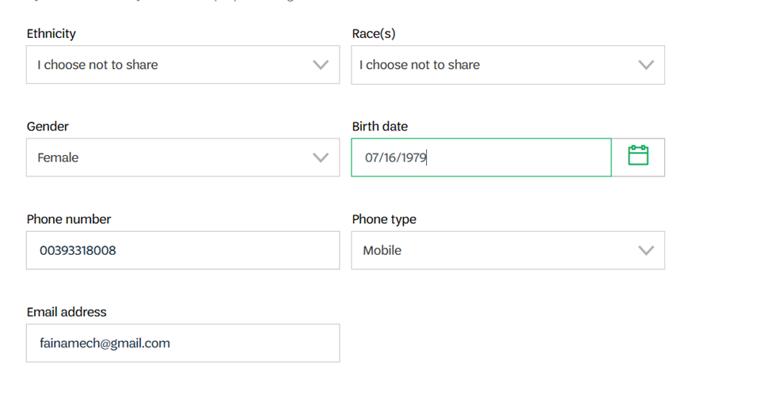
Notes:
Add details:
Volunteer position (if available) drop down menu
Select a contact
Complete address information – if using an international address, make sure to select correct country
Complete all the info required
Name and Last Name
Address
Country
DOB
Phone number
Phone type
Email address

Slide 11
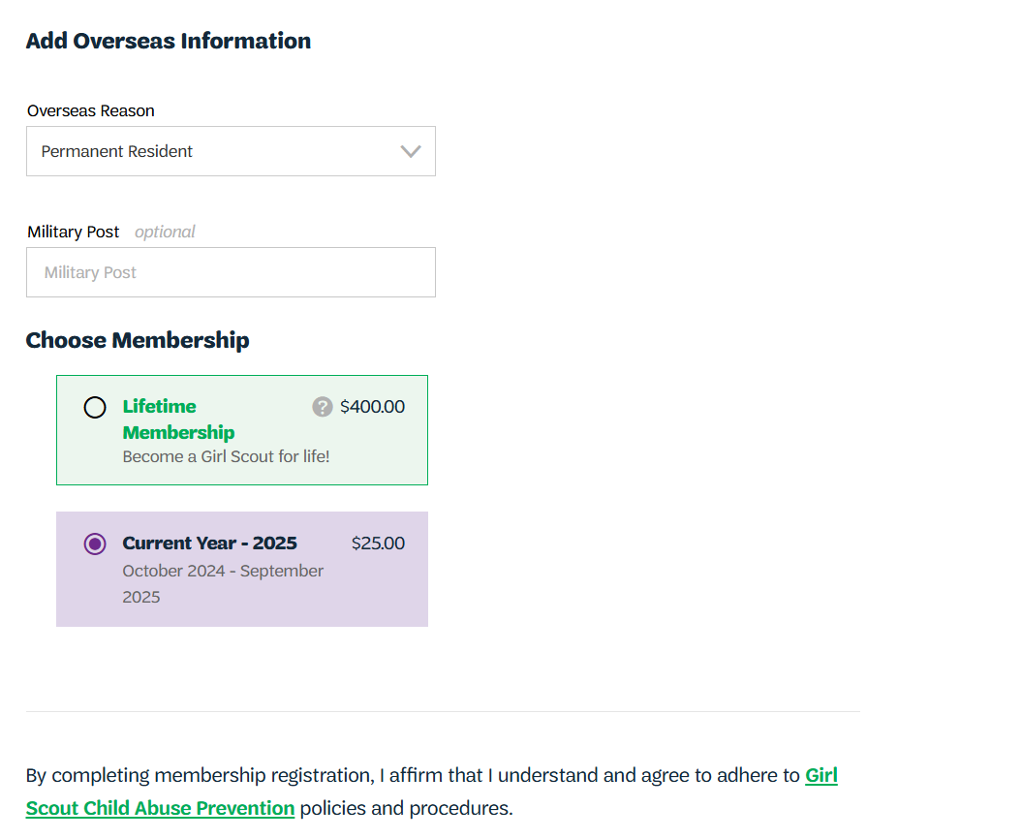
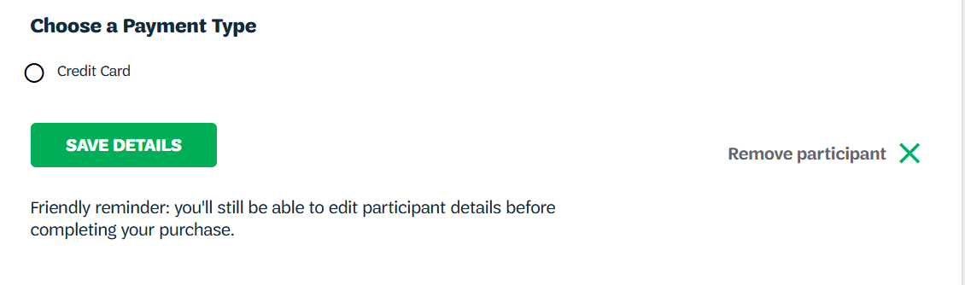
Notes:
Complete required information:
Overseas reason
Choose membership
Choose payment type
Save details

Slide 12
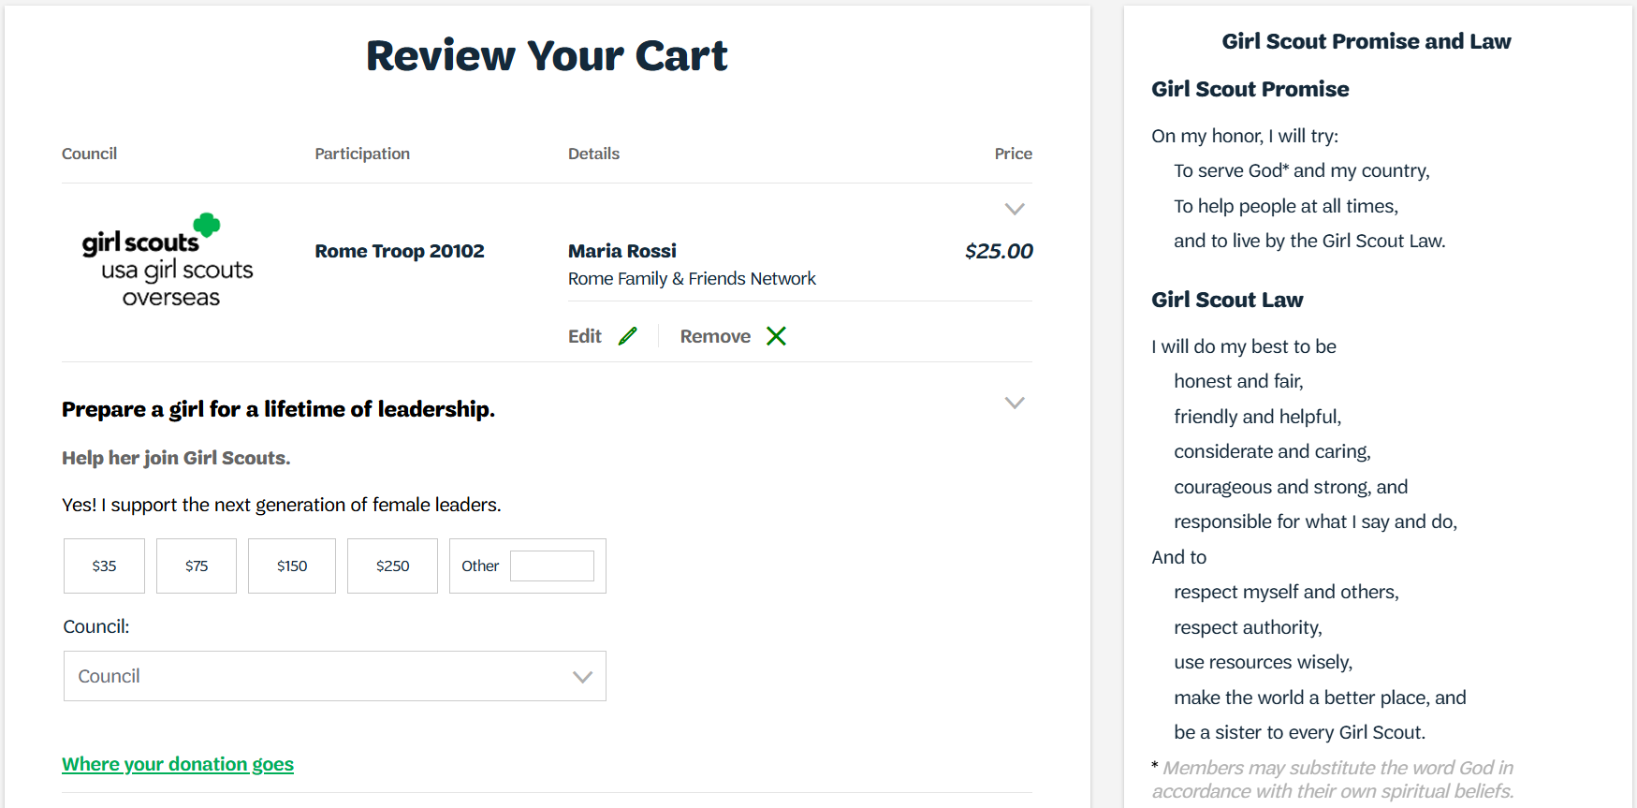
Notes:
Review your cart
Donations can also be completed in this page

Slide 13
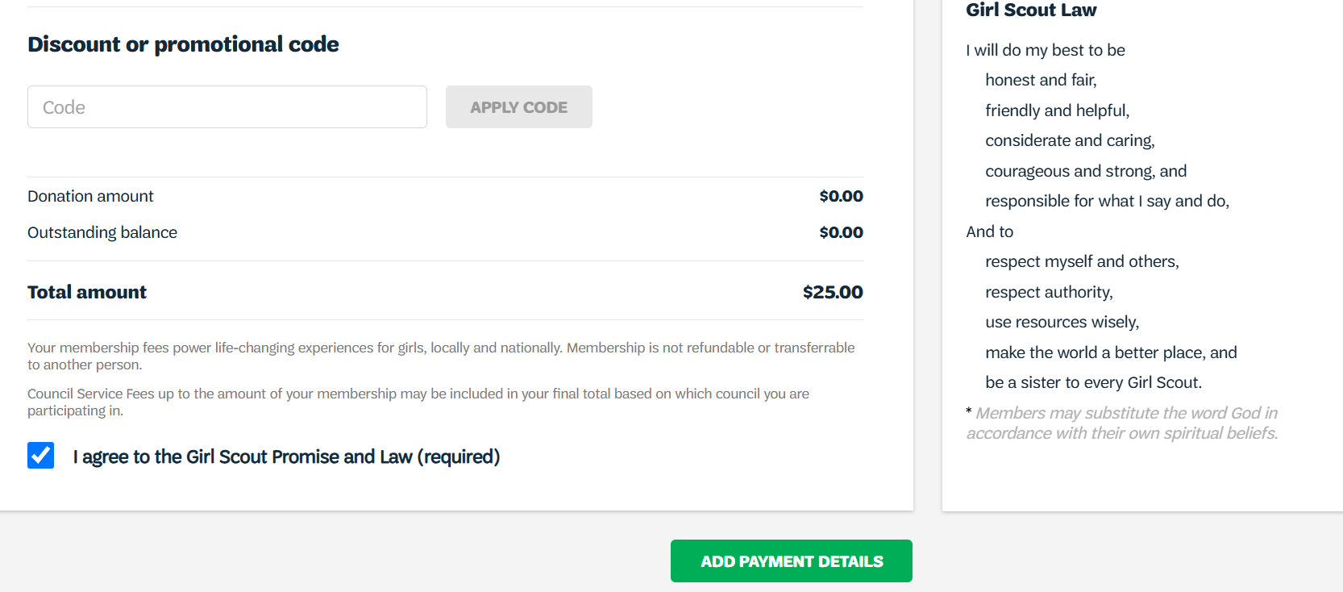
Notes:
If there is a discount code available, it can be used on this page under the “Discount or promotional code tab”
Click on “I Agree to the Girl Scouts Promise and Law”
Click on “Add Payment Details”

Slide 14
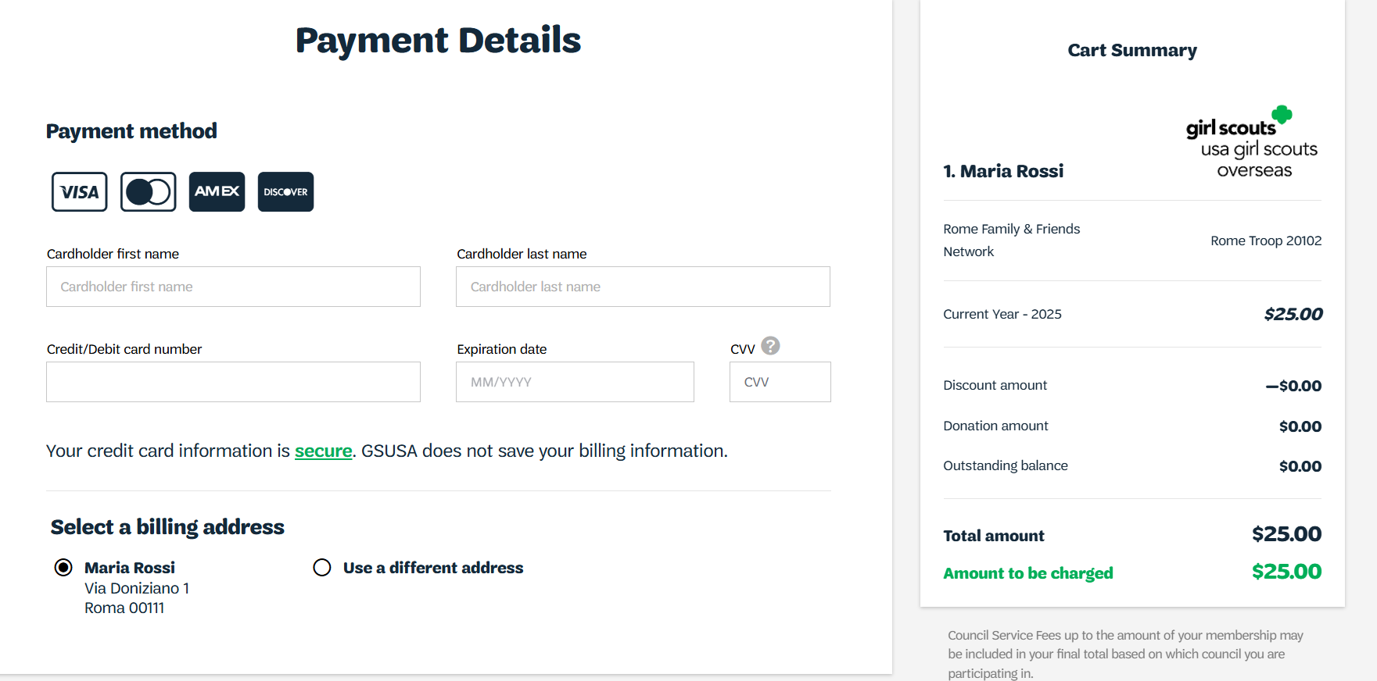
Notes:
Add payments details
If you are having issues with your credit card payment, please contact the Girl Scouts Overseas Customer Care for assistance. Payment confirmation will be received via email.

Slide 15
Thank you for participating!
For further questions, please contact Girl Scouts Overseas Customer Care at overseascustomercare@girlscouts.org
Notes:
Welcome to the Girl Scouts Overseas New Adult Registration Process training

