Slide 1
Girl Scouts Overseas
Girl Renewal
Registration
Process
Notes:
Welcome to the Girl Scouts Overseas Girl Renewal Registration Process training

Slide 2
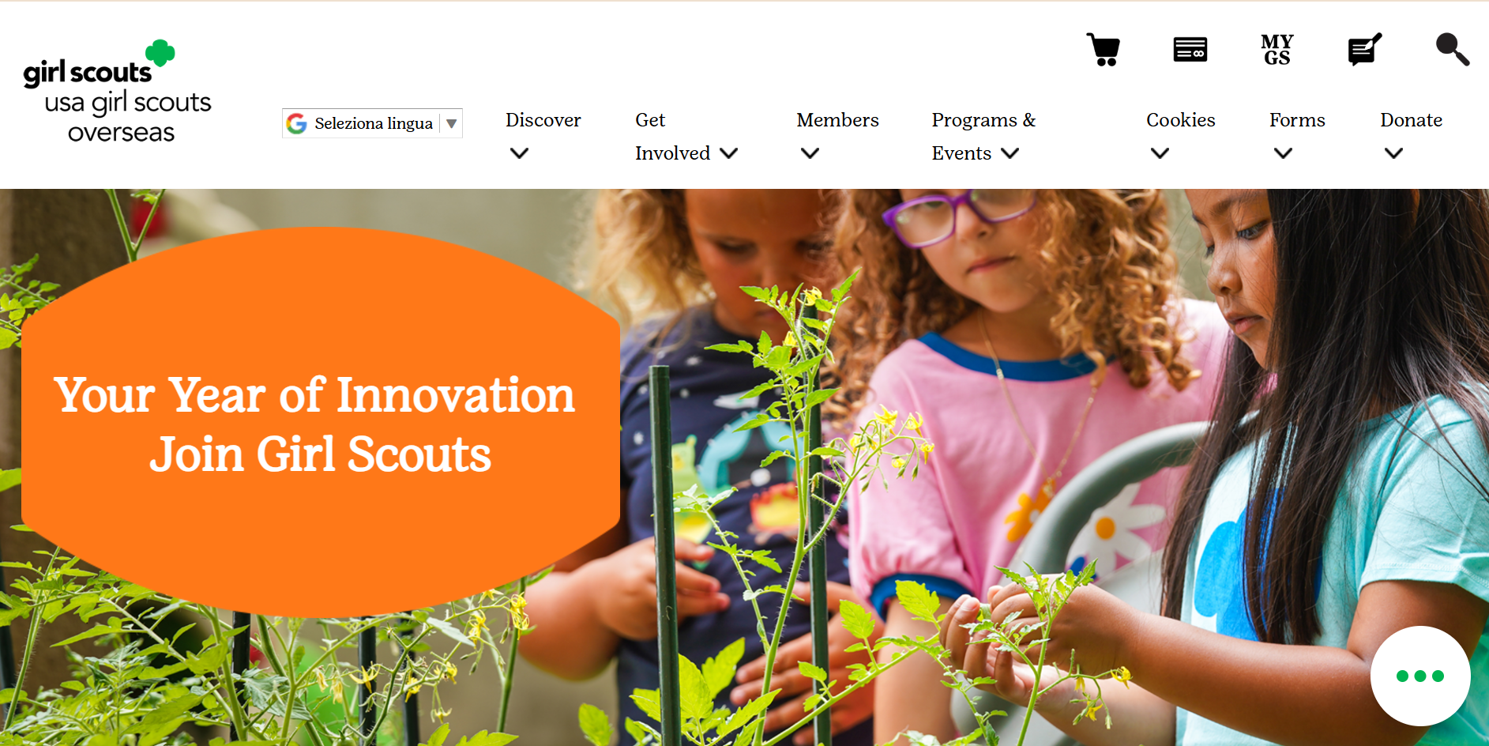


Notes:
On the USAGSO.ORG website, search for the MYGS tab on top of the screen

Slide 3
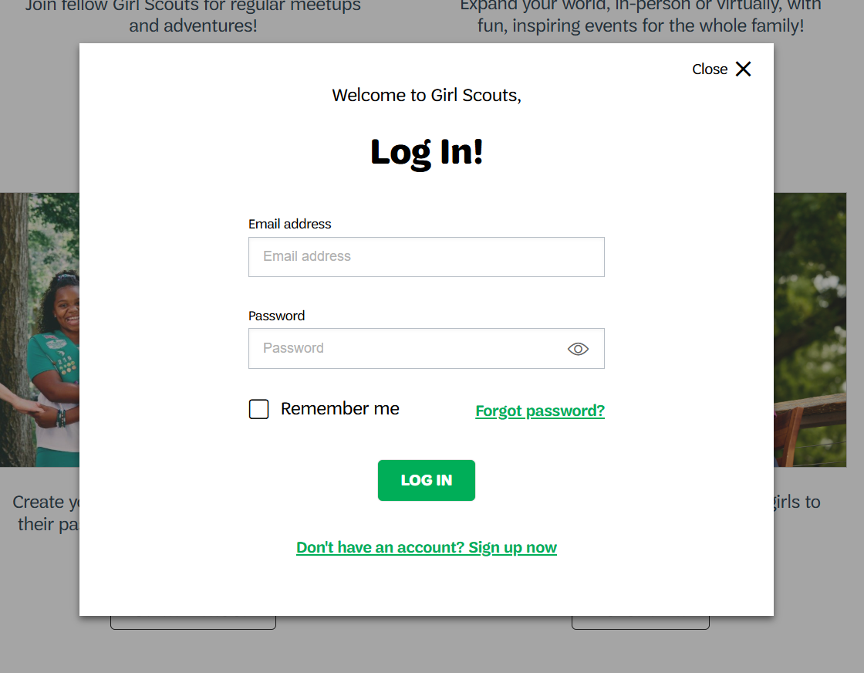
Notes:
A member pop-up window will ask to log in.
Log in into MyGS by using the credentials assigned.

Slide 4
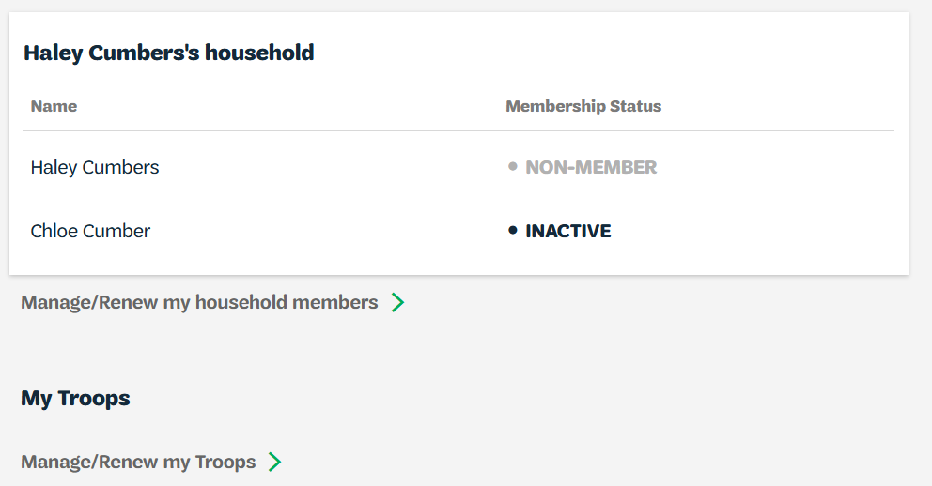
Notes:
On MyGS household account click on
Manage/renew my household members

Slide 5
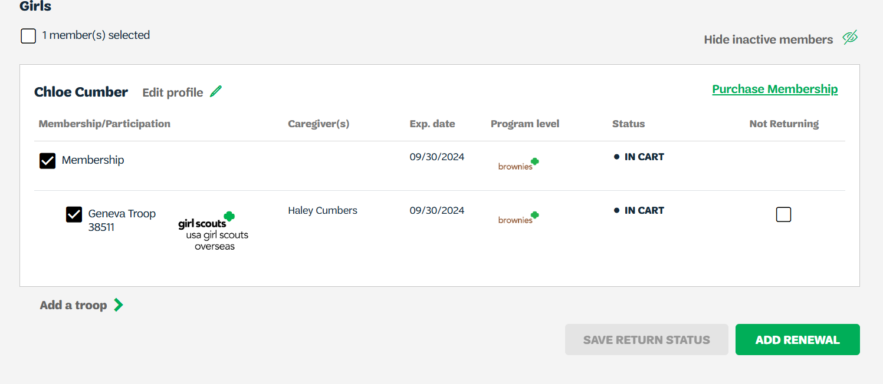
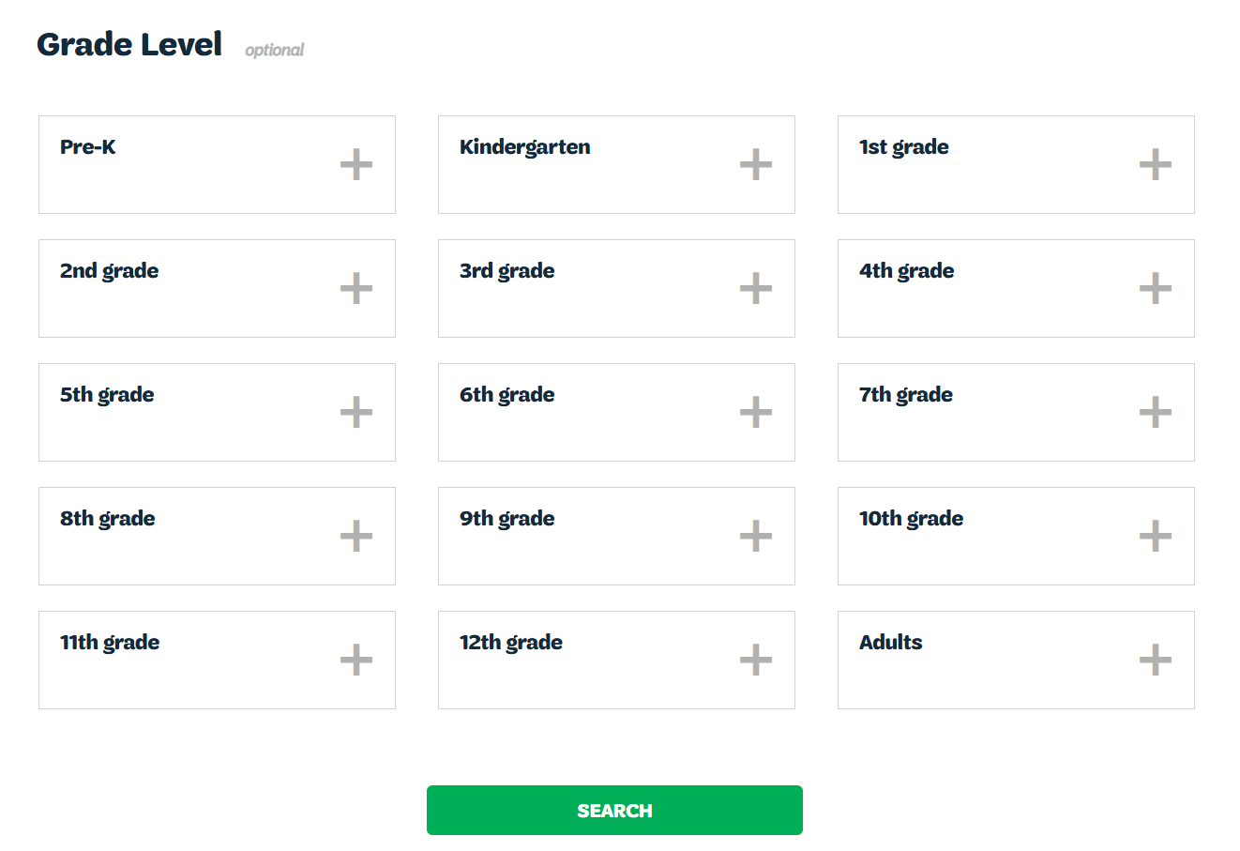
Notes:
Click on both Membership and Troop to renew the girl’s registration

Slide 6
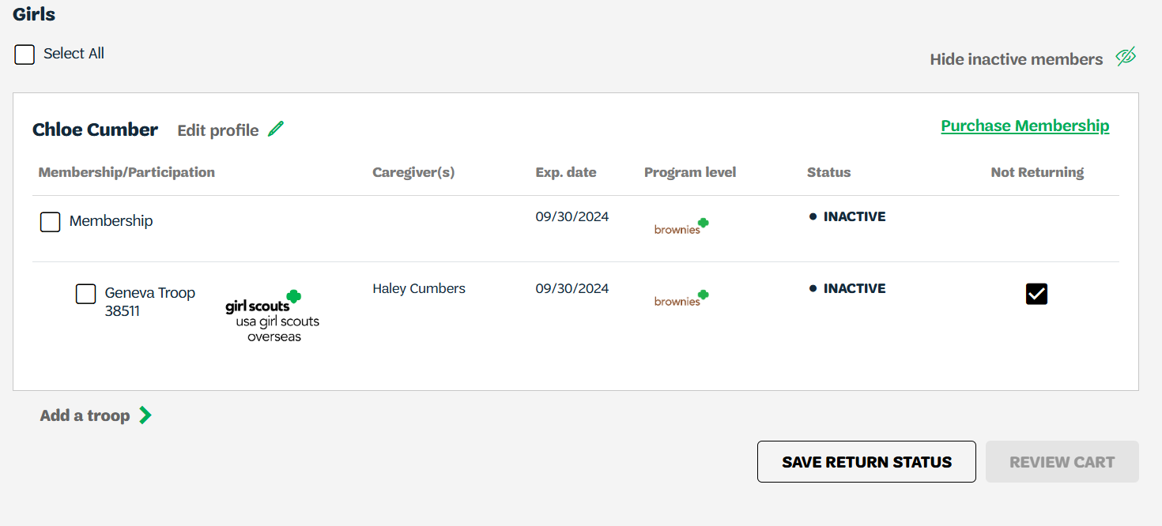
Notes:
If girl is registering for another troop, make sure to:
- uncheck current troop
click on not returning
Save return status
Click on Add a Troop

Slide 7
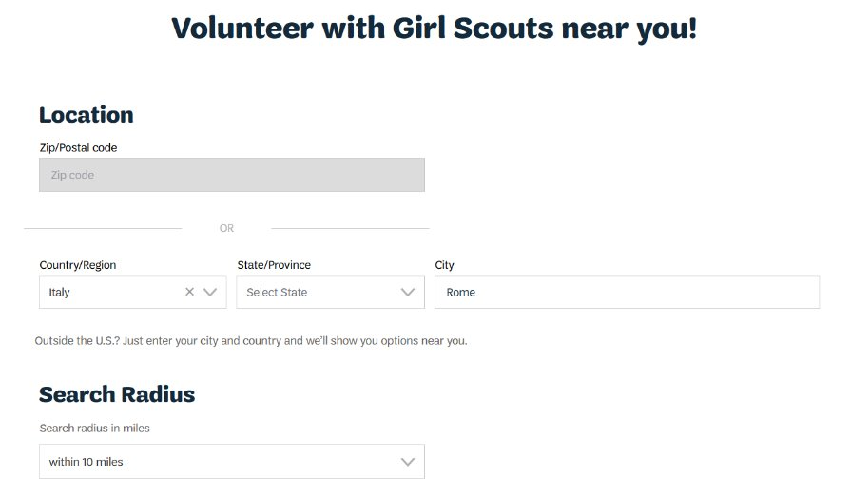
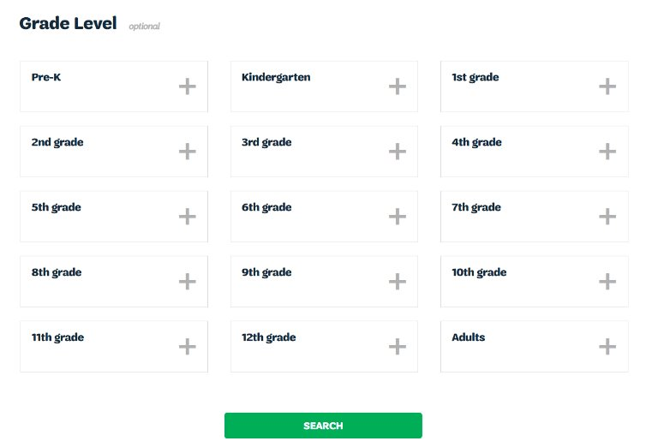
Notes:
Adjust filters according to troop location:
Country
Name of city/community
Search radius minimum to 20 miles
Choose grade level
Click Search
Choose preferred troop

Slide 8
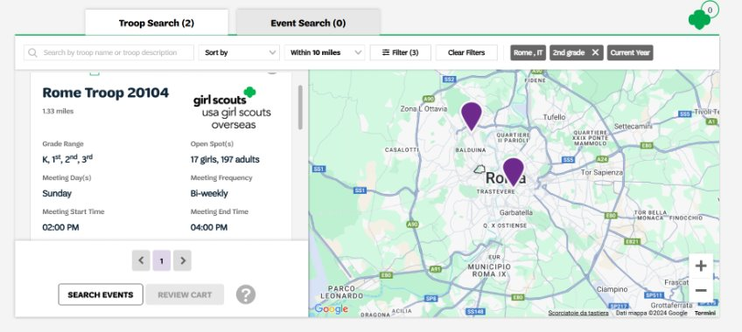
Notes:
Select troop availability
If searched troop is not available, select Unsure or Become a General Member
Select Next

Slide 9
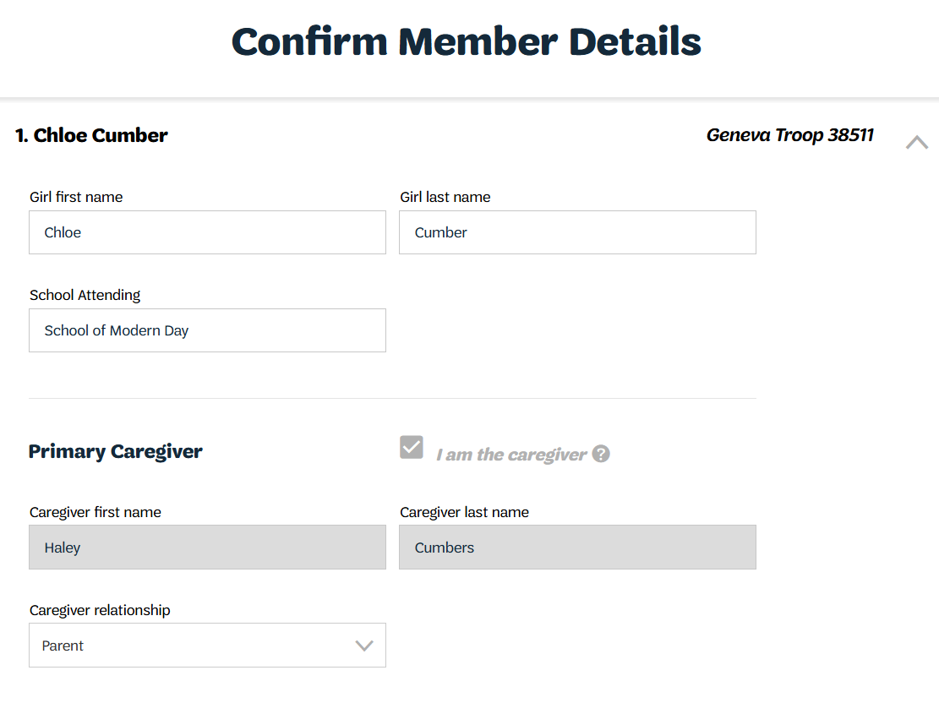
Notes:
Add details:
School Attending – add name of current school
Primary Caregiver is automatically checked by the system

Slide 10
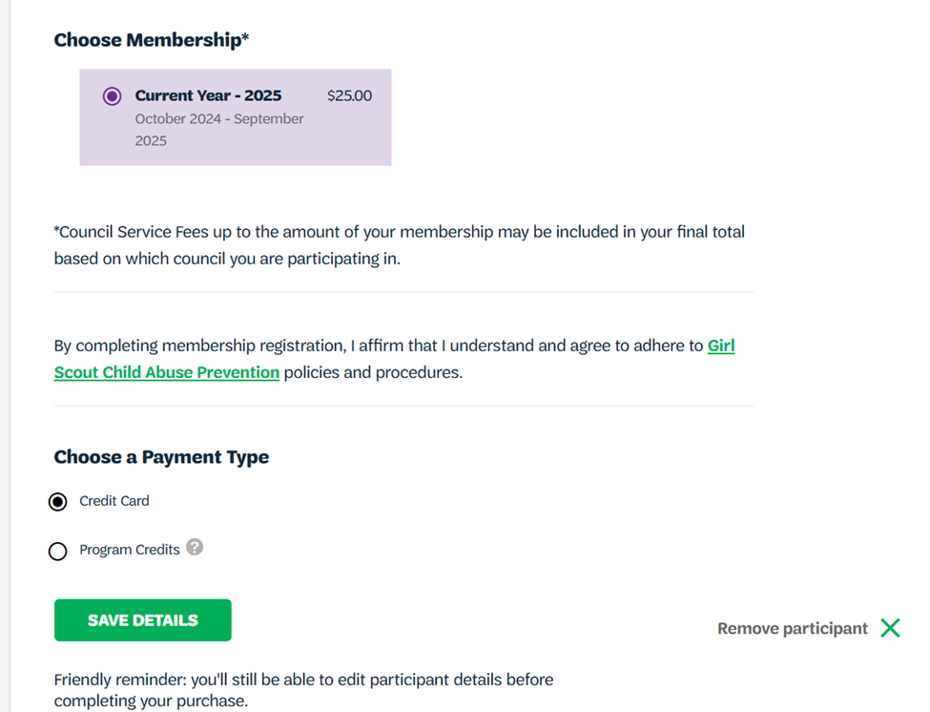
Notes:
Choose membership and payment type
USAGSO does not use Program Credits
Save details

Slide 11
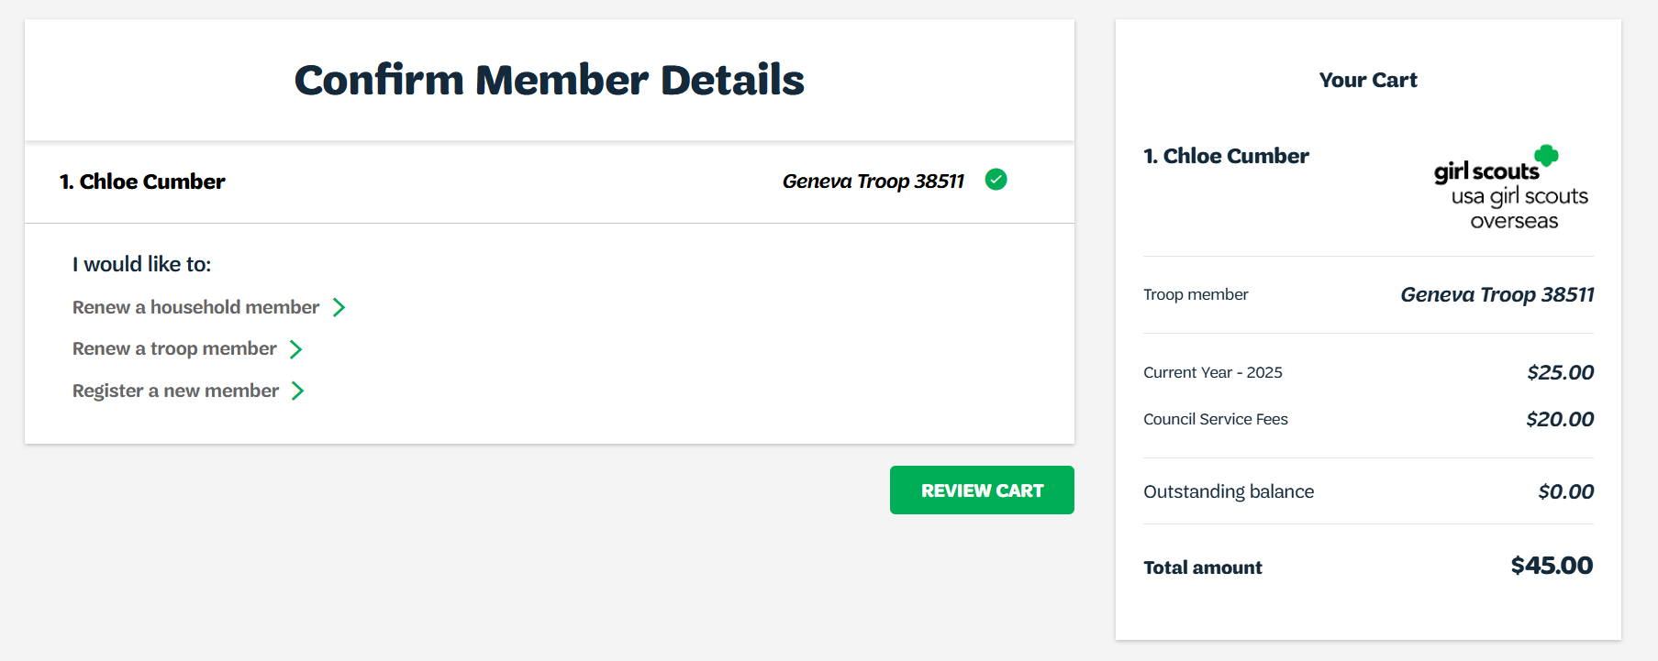
Notes:
Review Cart to check for any errors

Slide 12
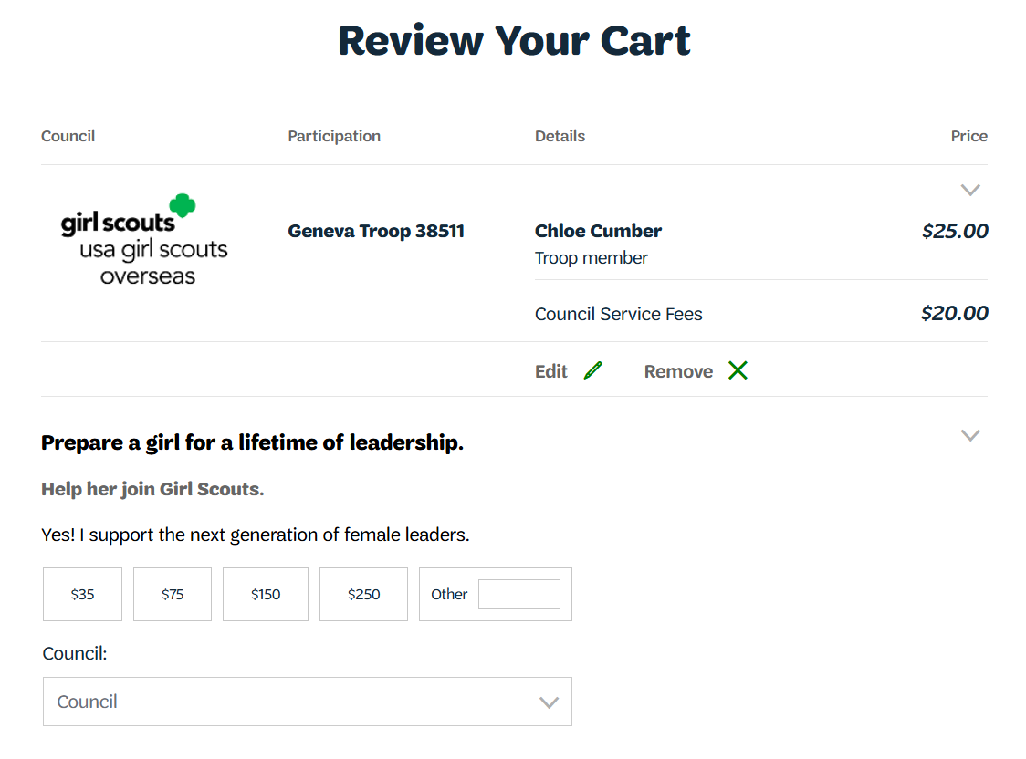
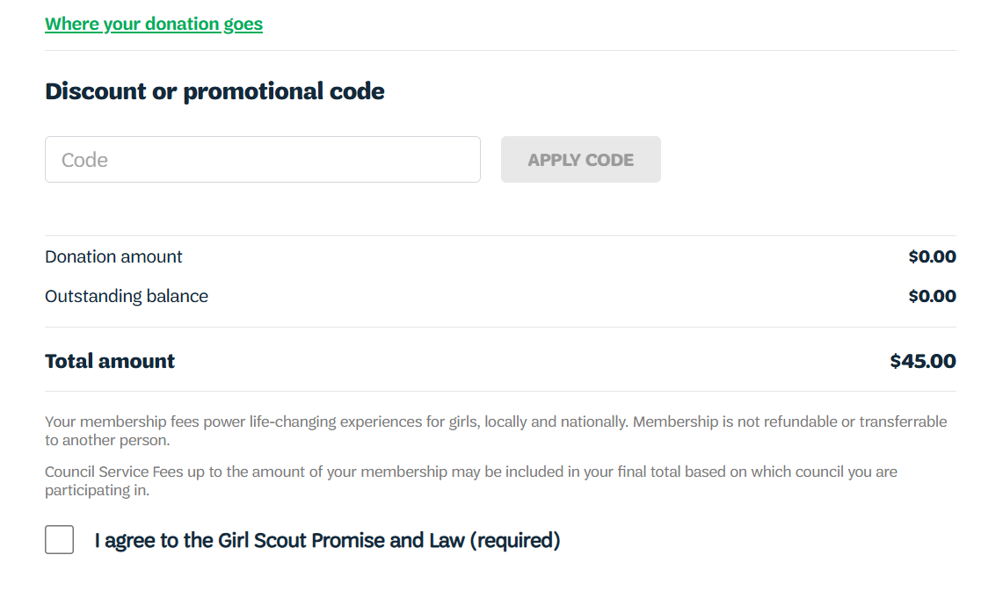
Notes:
Review your cart to check for errors
If there is a discount code available, it can be used on this page under the “Discount or promotional code tab”
Donations can also be completed in this page
If errors are present, click on edit
Click on “I Agree to the Girl Scouts Promise and Law”
Click on “Add Payment Details”

Slide 13
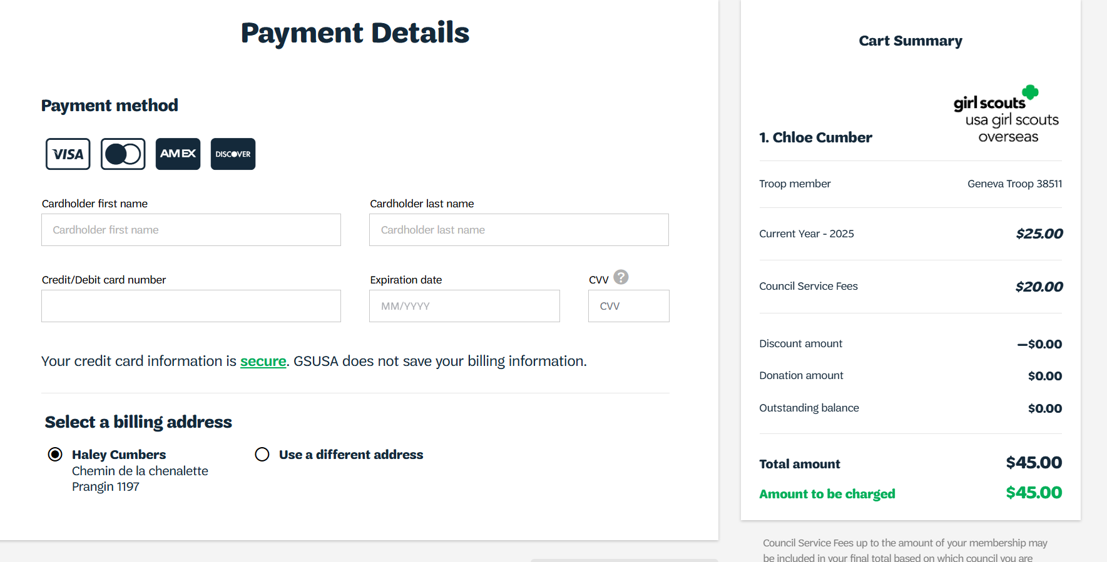
Notes:
Add payments details
If you are having issues with your credit card, please contact the Girl Scouts Overseas Customer Care for assistance. Payment confirmation will be received via email.

Slide 14
Thank you for participating!
For further questions, please contact Girl Scouts Overseas Customer Care at overseascustomercare@girlscouts.org
Notes:
Thank you for attending the Girl Scouts Overseas Girl Renewal training. For further questions or need any assistance, please contact the Girl Scouts Overseas Customer Care Team at overseascustomercare@girlscouts.org

