Slide 1
Girl Scouts Overseas
Bulk Renewal Roster Registration
Process
Notes:
Overseas Committee Chairs, Registrars and all of those that apply within a Girl Scouts community can submit the bulk registration roster to their Membership Managers or to Overseas Customer Care at overseascustomercare@girlscouts.org.

Slide 2
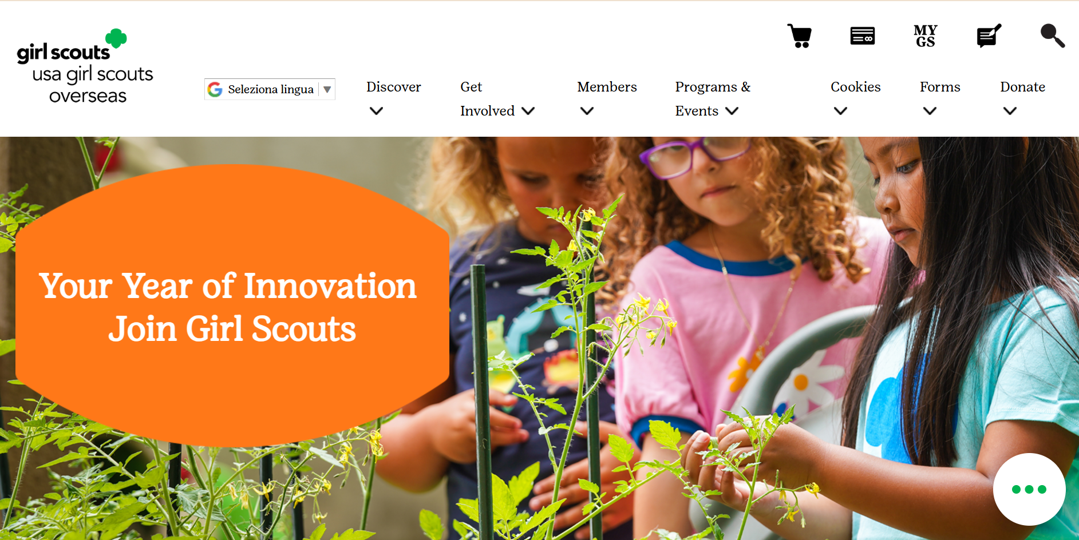
Notes:
To retrieve a blank roster, access the USAGSO.ORG website and search for “Forms” on top of the screen.

Slide 3
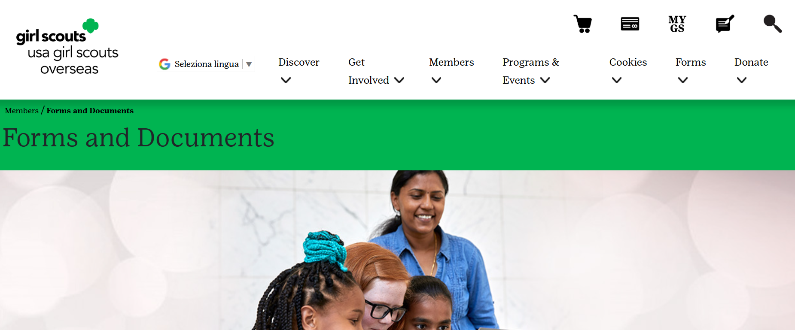
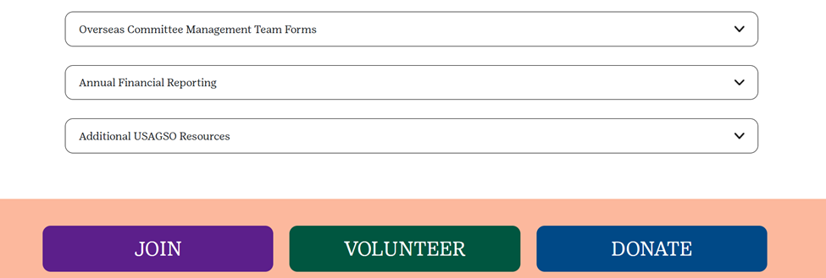
Notes:
Under Forms and Documents page, scroll to the bottom of the page and click on Additional USAGSO Resources

Slide 4
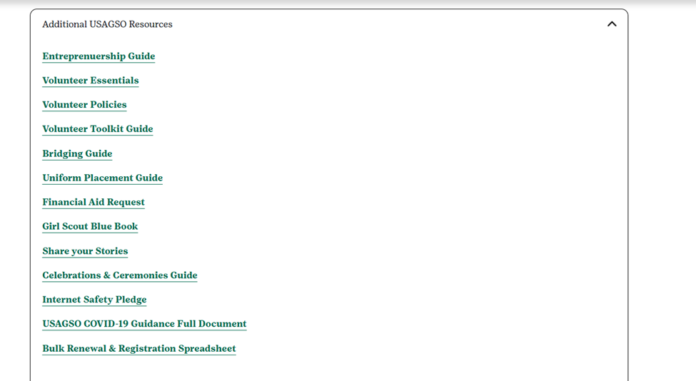
Notes:
A dropdown menu will show a list of available sources, the Bulk Renewal Roster will be available at the bottom of the page.
Click on the link to download the spreadsheet.
If the member is having difficulties in retrieving the form from the website, please contact your Membership Manager.

Slide 5
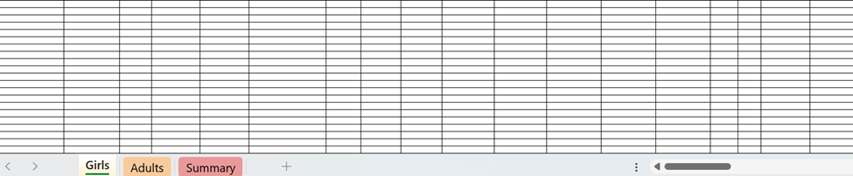

Notes:
Once downloaded the Bulk Renewal Roster document will open as an Excel spreadsheet and it includes 3 different tabs:
Girls
Adults
Summary

Slide 6
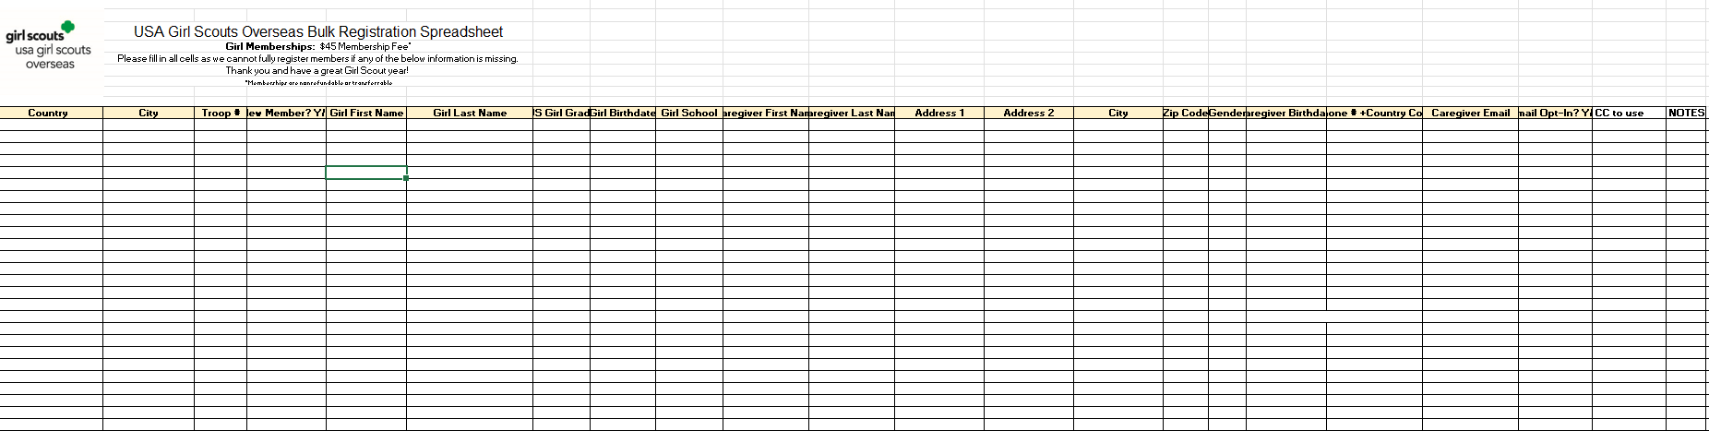
Notes:
The Girls tab includes the following information that is required for the completion of the registration process:
Country
City
Troop #
Girl School
The following information is mandatory:
Girl First Name
Girl Last Name
US Girl Grade
Girl DOB
Caregiver First Name
Caregiver Last Name
Caregiver DOB
Address
City
Zip Code
Phone Number
Email address
The above information, if missing, will be subjected to review.
Volunteers can retrieve the girls’ information from Looker reports associated to their community.

Slide 7
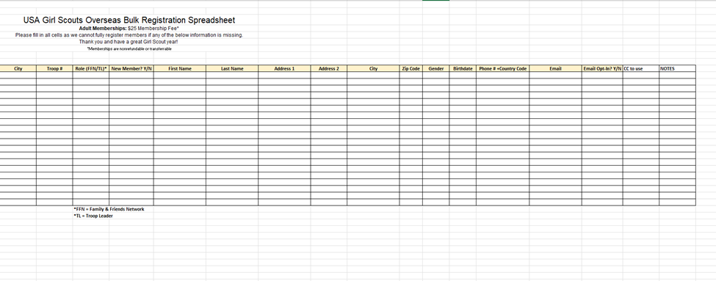
Notes:
The Adults tab includes the following mandatory info:
First Name
Last Name
Address
DOB
Phone Number
Email address

Slide 8
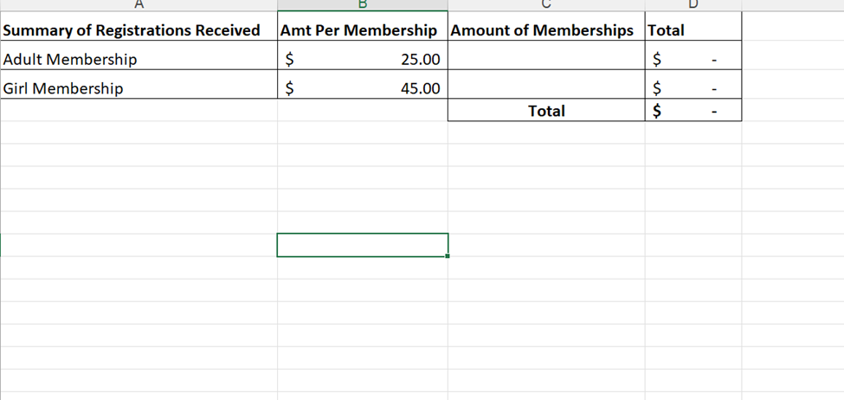
Notes:
The Summary Tab serves to summarize the number of girls and adult registrations.
Be aware that coupons, discounts, promotions are not applicable to Bulk Renewal Rosters.
Once the Roster is completed, submit the roster to your Membership Manager or to the Overseas Customer Care Team at overseascustomercare@girlscouts.org.
Once the roster is reviewed, an invoice for payment will be sent by the Girl Scouts Overseas Finance office.
Upon payment is received, the registrations will be processed.

Slide 9
Smart Steps
Bulk Registration Rosters are for 10 or more girls
Coupon codes cannot be used with Bulk Registration Rosters
Make sure all required information is included before submitting the Bulk Registrations Rosters
Bulk Registrations Rosters will not be processed until payment is complete
Notes:
Tip Sheet:

Slide 10
Thank you for participating!
For further questions, please contact Girl Scouts Overseas Customer Care at overseascustomercare@girlscouts.org
Notes:
Thank you for attending the Girl Scouts Overseas Bulk Renewal Roster training. For further questions or need any assistance, please contact the Girl Scouts Overseas Customer Care Team at overseascustomercare@girlscouts.org

