Slide 1
Girl Scouts Overseas
Adult Renewal Registration
Process
Notes:
Welcome to the Girl Scouts Overseas Adult Renewal Registration Process training

Slide 2
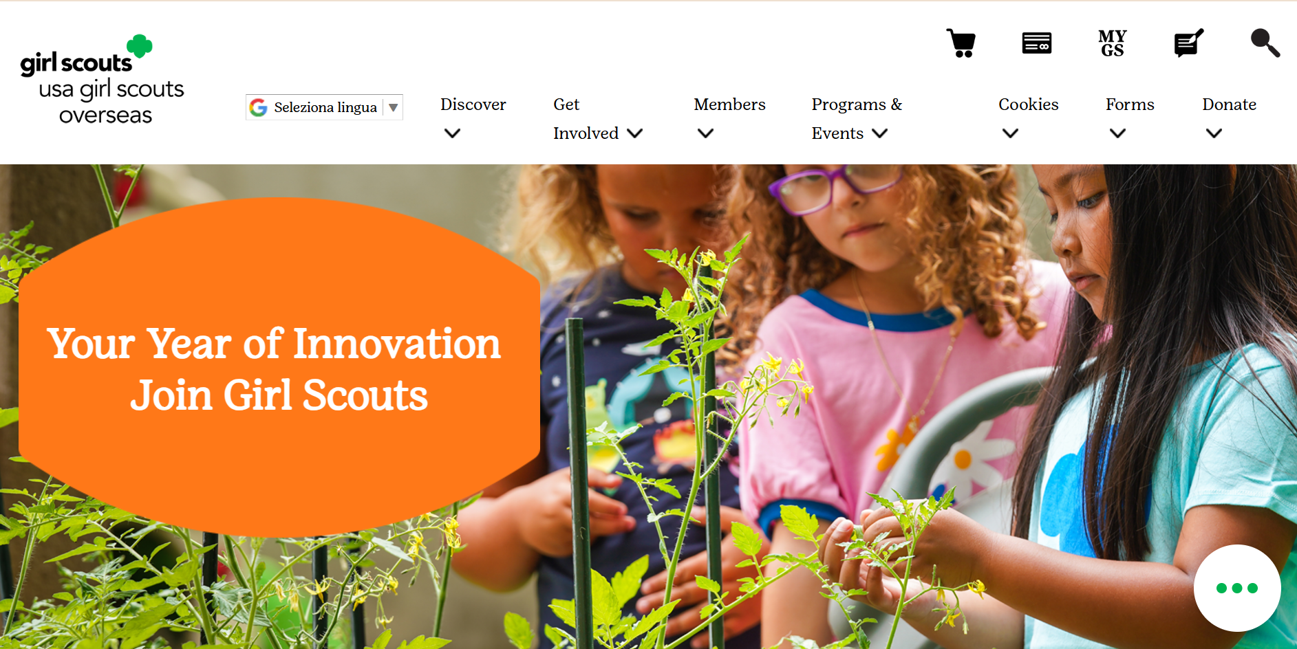


Notes:
On the USAGSO.ORG website, search for the MYGS tab on top of the screen

Slide 3
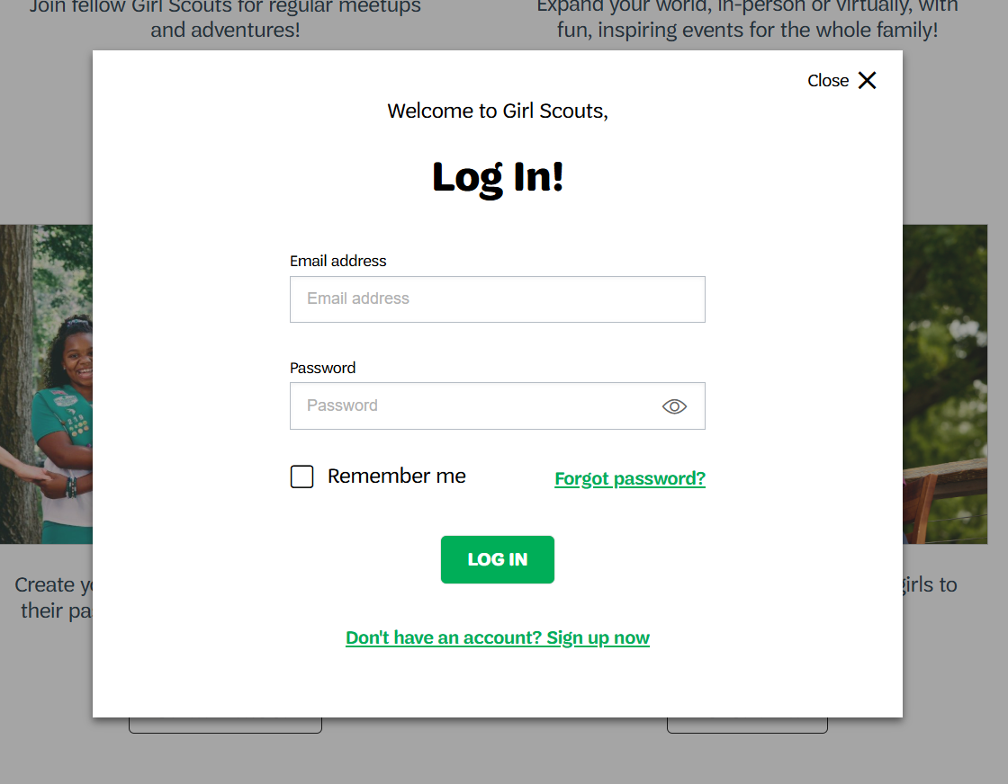
Notes:
A member pop-up window will ask to log in.
Log in into MyGS by using the credentials assigned.

Slide 4
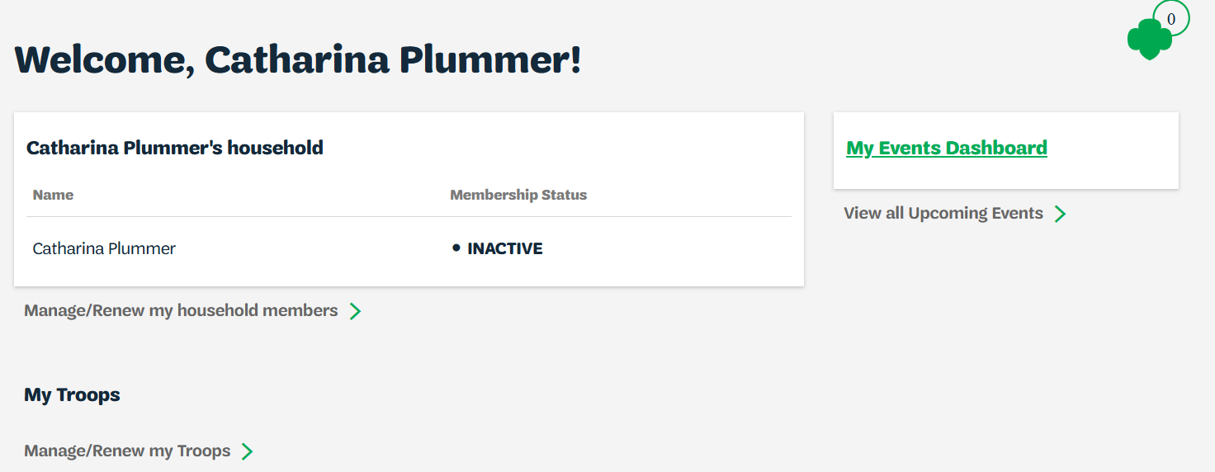
Notes:
On MyGS household account click on:
Manage/renew my household members

Slide 5
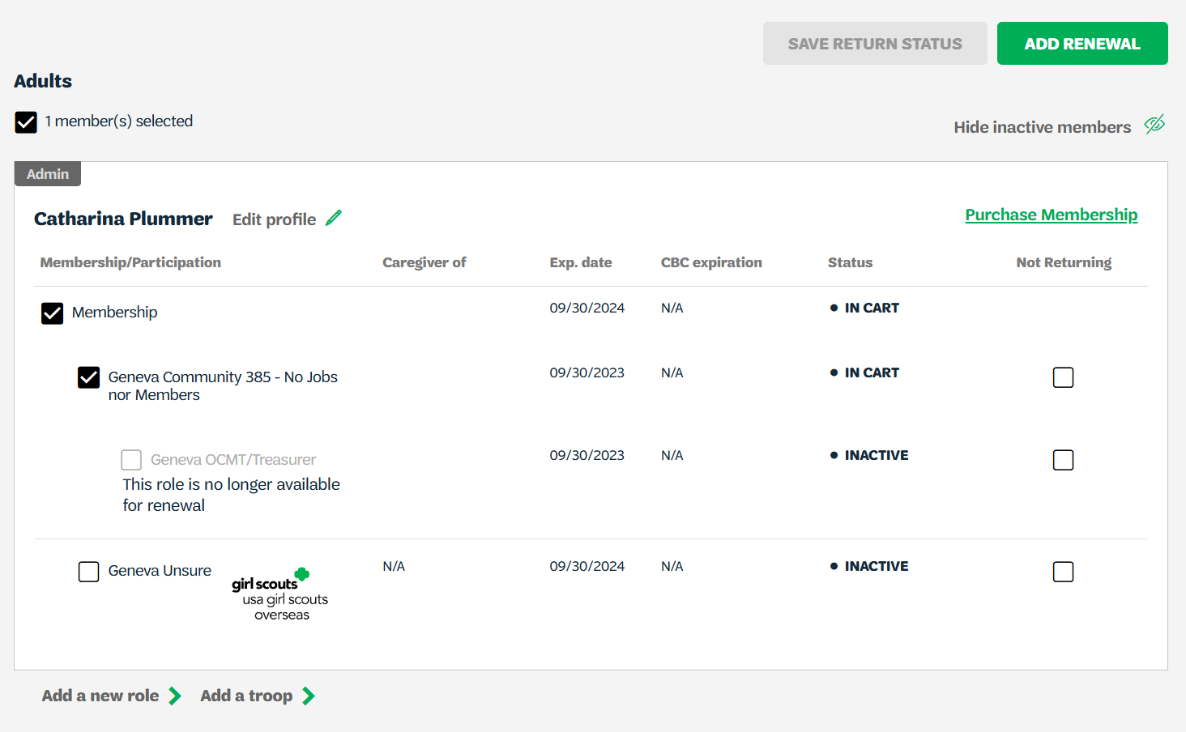
Notes:
Click on both Membership/Participation to renew the adult’s registration and click renewal on Add Renewal on top of the page

Slide 6
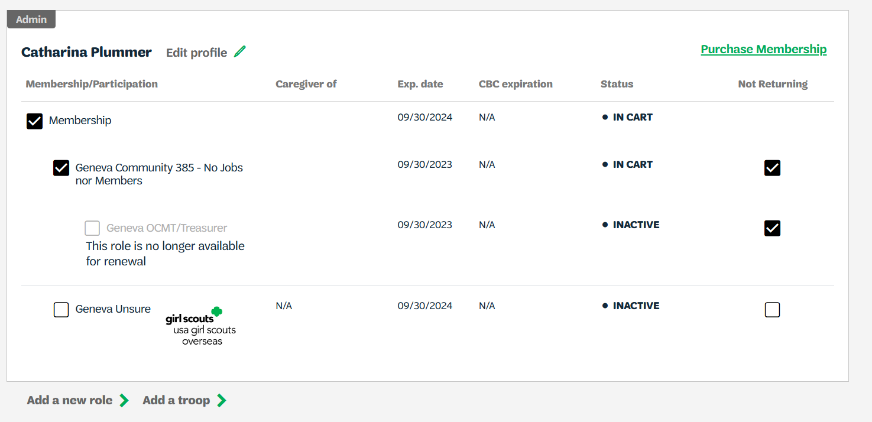
Notes:
If adult is registering for another role, make sure to:
- uncheck current role
click on not returning
Save return status
Then Click on Add a New Role

Slide 7
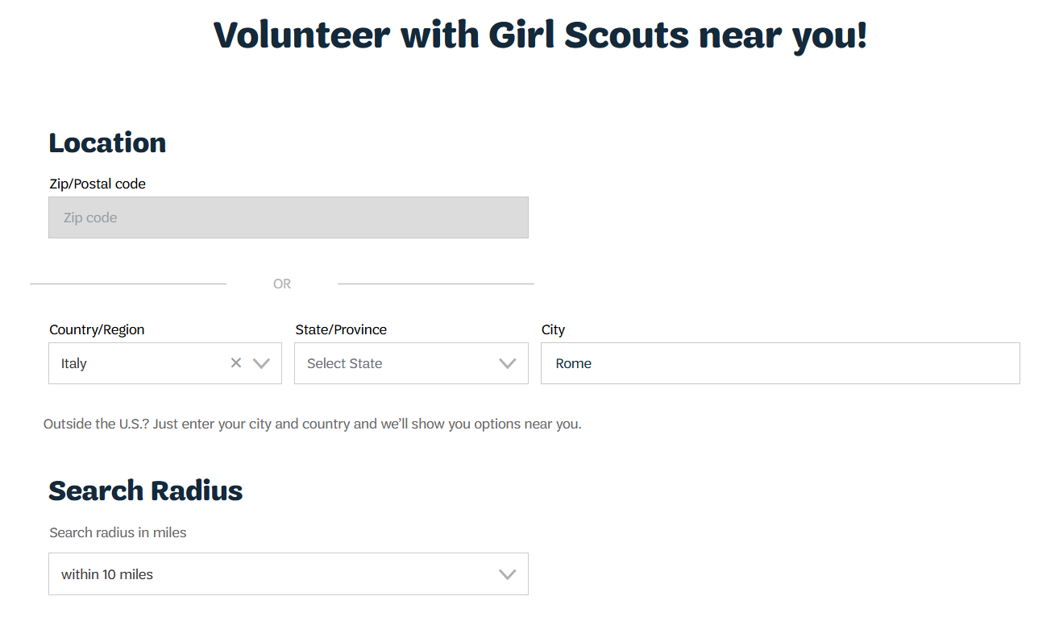
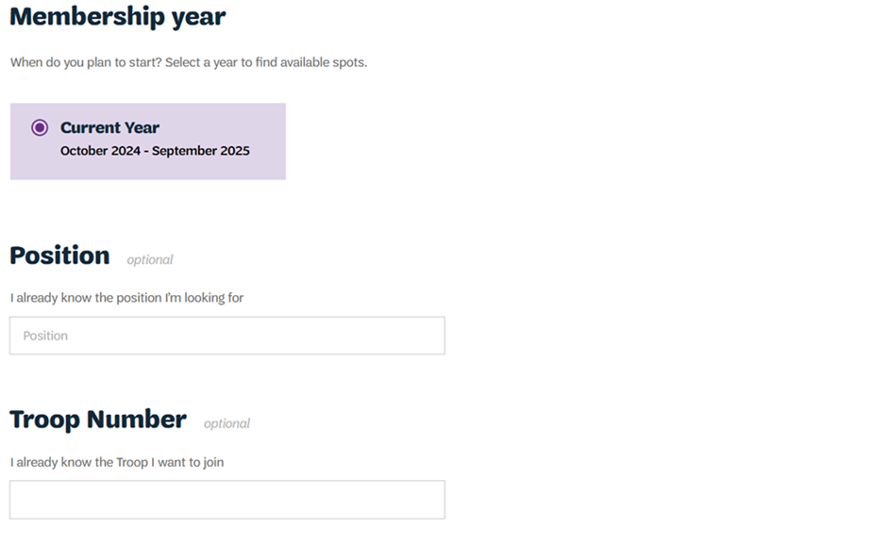
Notes:
Adjust filters according to troop location:
Country
Name of city/community
Search radius minimum to 20 miles

Slide 8
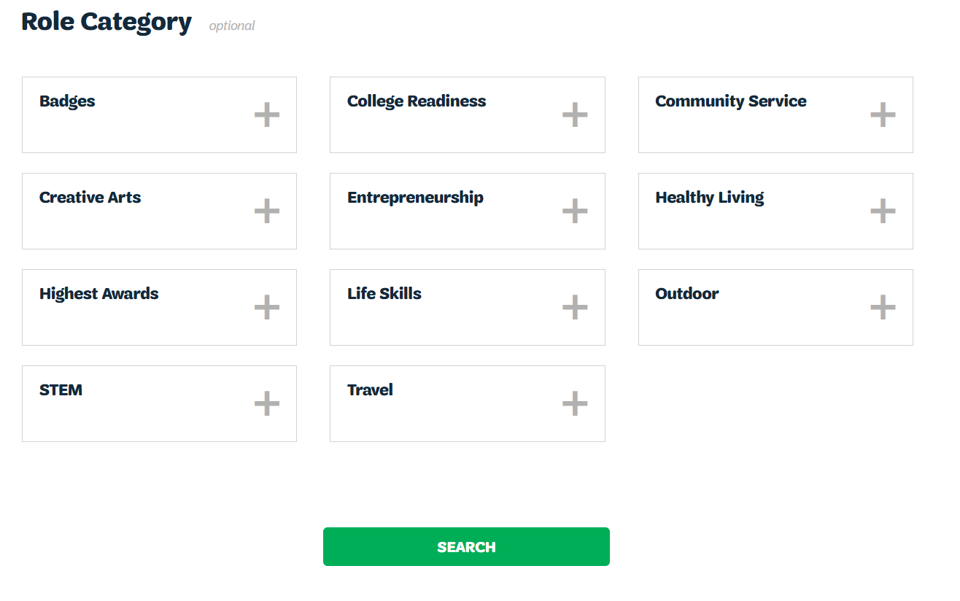
Notes:
Click Search

Slide 9
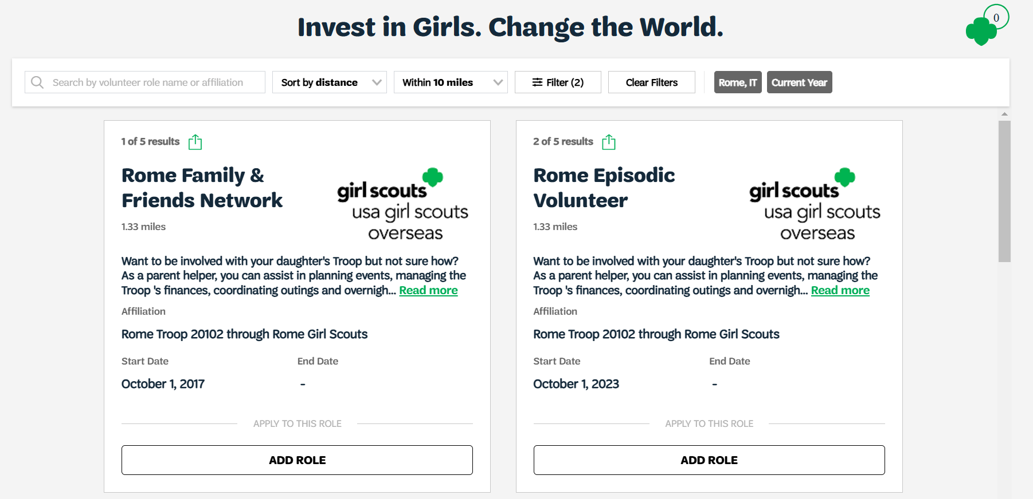
Notes:
Choose preferred troop
Click on Add Role

Slide 10
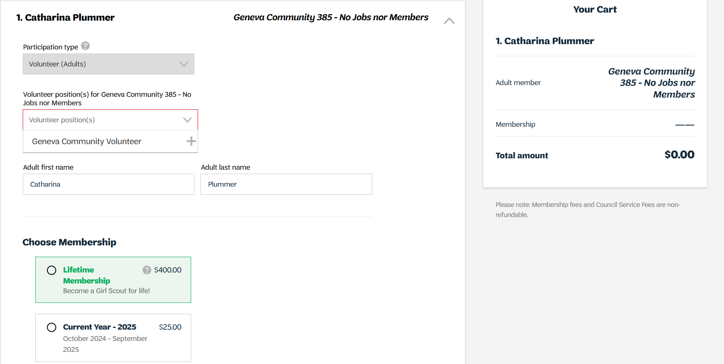
Notes:
Add details:
Participation type
Volunteers Position – Choose all that apply
For “Choose Membership” – adults can apply for the Lifetime membership option to if desired

Slide 11
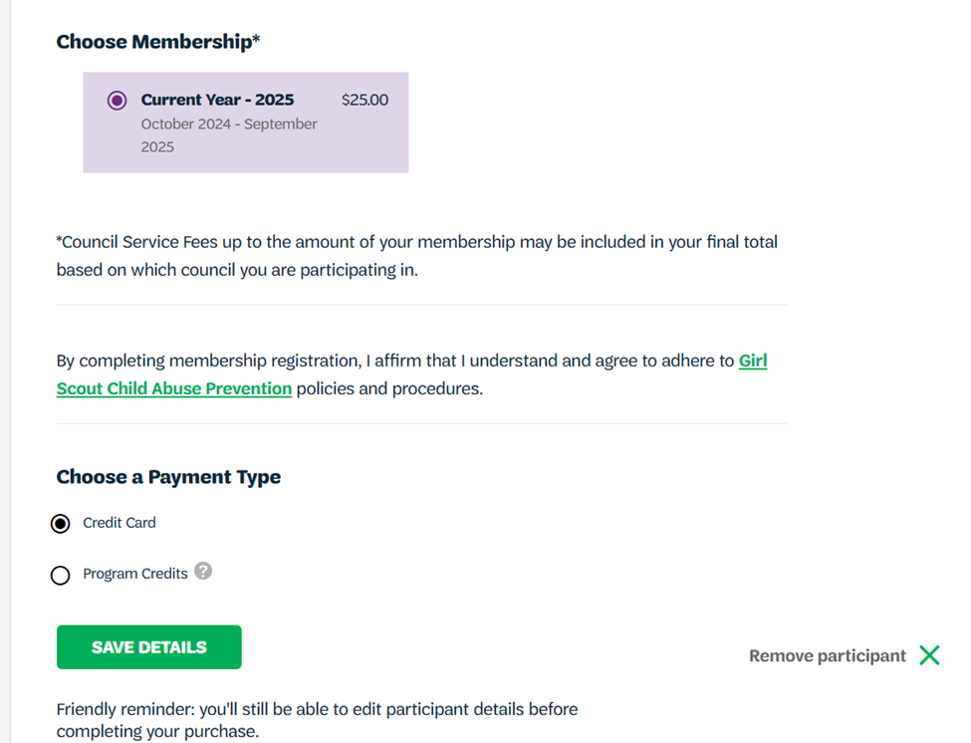
Notes:
Choose membership and payment type
USAGSO does not use Program Credits
Save details

Slide 12
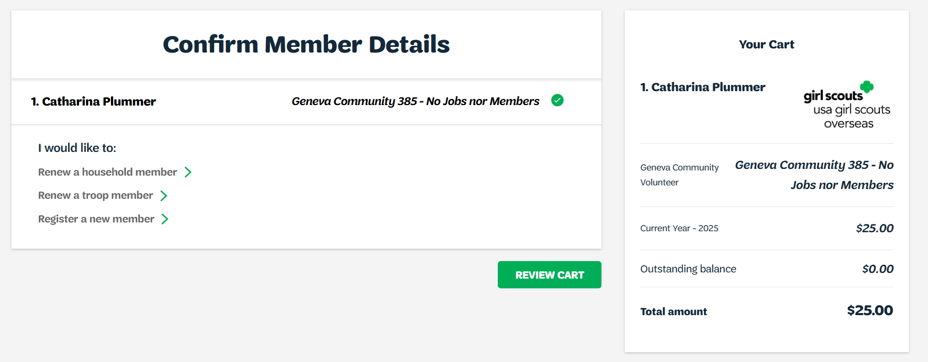
Notes:
Click on Review Cart to check for any errors

Slide 13
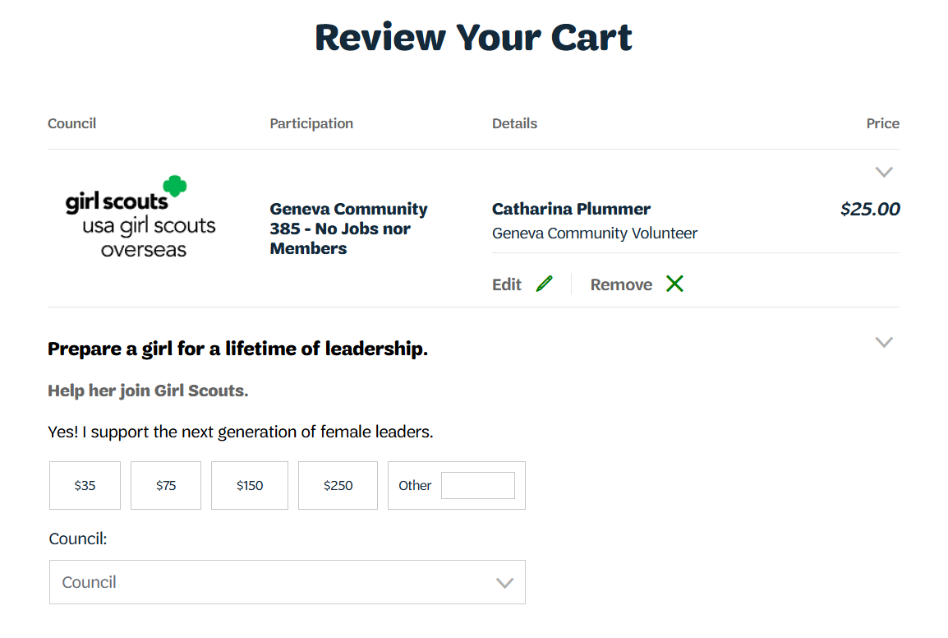
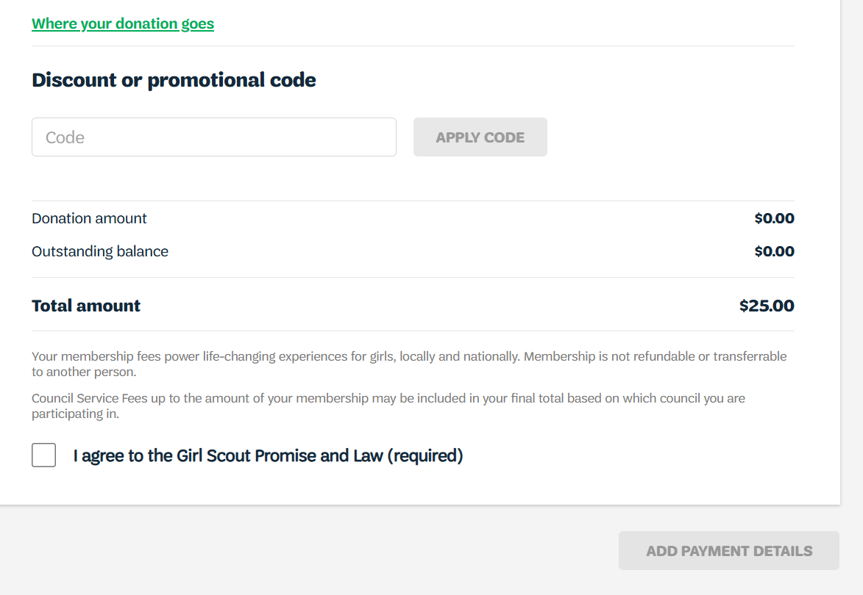
Notes:
Review your cart to check for errors
If there is a discount code available, it can be used on this page under the “Discount or promotional code tab”
Donations can also be completed in this page
If errors are present, click on edit
Click on “I Agree to the Girl Scouts Promise and Law”
Click on “Add Payment Details”

Slide 14
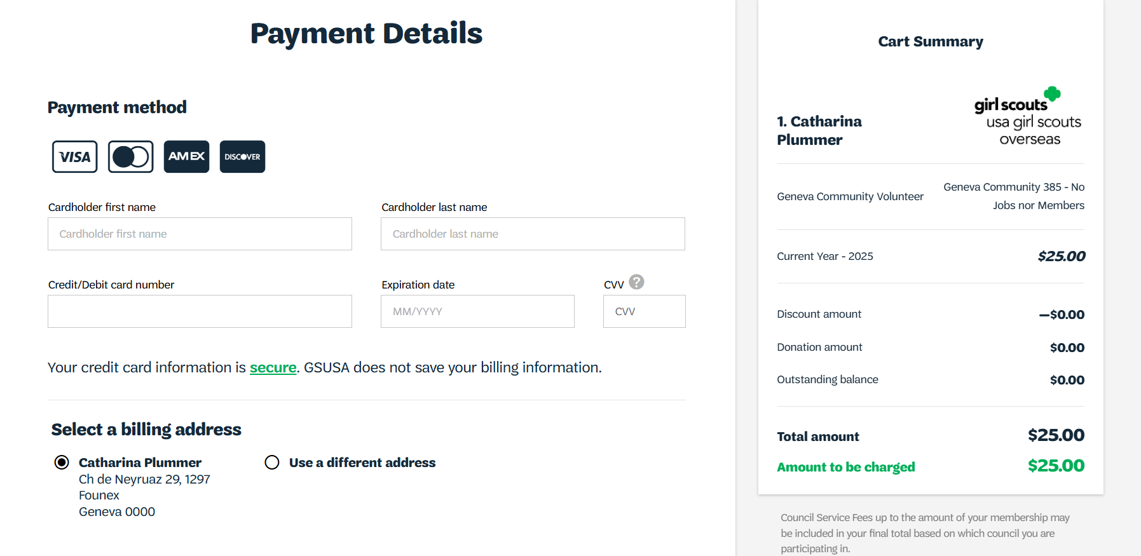
Notes:
Add payments details
If you are having issues with your credit card, please contact the Girl Scouts Overseas Customer Care for assistance. Payment confirmation will be received via email.

Slide 15
Thank you for participating!
For further questions, please contact Girl Scouts Overseas Customer Care at overseascustomercare@girlscouts.org
Notes:
Thank you for attending the Girl Scouts Overseas Adult Renewal training. For further questions or need any assistance, please contact the Girl Scouts Overseas Customer Care Team at overseascustomercare@girlscouts.org

